Slide 1
Unit-4

Slide 2
Decision trees
A Decision Tree is a supervised machine learning algorithm used for both:
Classification (predicting categories like “yes/no”, “spam/not spam”), and
Regression (predicting continuous values like “price”, “age”, “temperature”).
It works by splitting data into branches based on certain conditions — forming a tree-like structure where:
Root Node: The initial node at the beginning of a decision tree, where the entire population or dataset starts dividing based on various features or conditions.
Internal node(Decision node): represents a decision based on a feature/attribute (like “Age < 30?”). These nodes represent intermediate decisions or conditions within the tree
Each branch represents the outcome/value of that attribute/decision (like “Yes” or “No”). It is the path or edge that connects one node to another.
Each leaf node represents the final prediction (like “Will Buy = Yes”). It doesn’t split further.
Notes:
1. Decision nodes: It asks a question about one of the input features
That node splits the dataset into smaller parts based on the answer: (If-else)
Yes → one subset of data
No → another subset
Internal nodes always have outgoing branches — they’re not the final answers.
2. Branches can lead to:
Another internal node (if we have more conditions to test), or
A leaf node (if we’re ready to make a prediction).

Slide 3
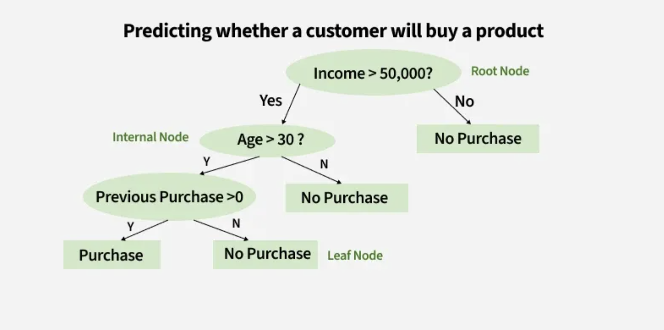
It starts from a single root node (the first question), and branches out based on answers (conditions). You continue splitting and follow the path until you reach a leaf node that gives the answer.
It mimics how humans make decisions:
“Is it raining? → Yes → Take umbrella” “Is it raining? → No → Don’t take umbrella”
Applications: Classification of diseases, fault detection, loan approval.

Slide 4
Decision trees
How Decision Trees Work (Step-by-Step)
Select the Best Feature to Split
The algorithm chooses the feature that best divides the data into pure classes.
For this, it uses metrics like:
Information Gain (based on Entropy)
Gini Index
Split the Dataset
Divide the dataset based on the selected feature.
Repeat Recursively
Keep splitting each subset until:
All samples in a node belong to the same class, or
The maximum depth is reached.
Assign Labels to Leaf Nodes
When no more splits can be made, assign the most common class (for classification) or average value (for regression).

Slide 5
ID3 algorithm
ID3 (Iterative Dichotomiser 3) is a decision tree algorithm developed by Ross Quinlan in 1986.
It’s used for classification tasks — that is, predicting categorical outcomes (like Yes/No, Play/Don’t Play, etc.).
ID3 builds a decision tree by choosing the attribute that gives the most information about the target class at each step/which attribute should be tested at the root of the tree?
Each instance attribute is evaluated using a statistical test to determine how well it alone classifies the training examples. The best attribute is selected and used as the test at the root node of the tree.

Slide 6
ID3 algorithm
It uses two key ideas:
Entropy → measures how impure or mixed a dataset is.
Information Gain → measures how much purity increases when we split using a particular attribute. It measures how well a given attribute separates the training examples according to their target classification. ID3 uses this information gain measure to select among the candidate attributes at each step while growing the tree.

Slide 7
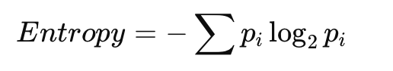
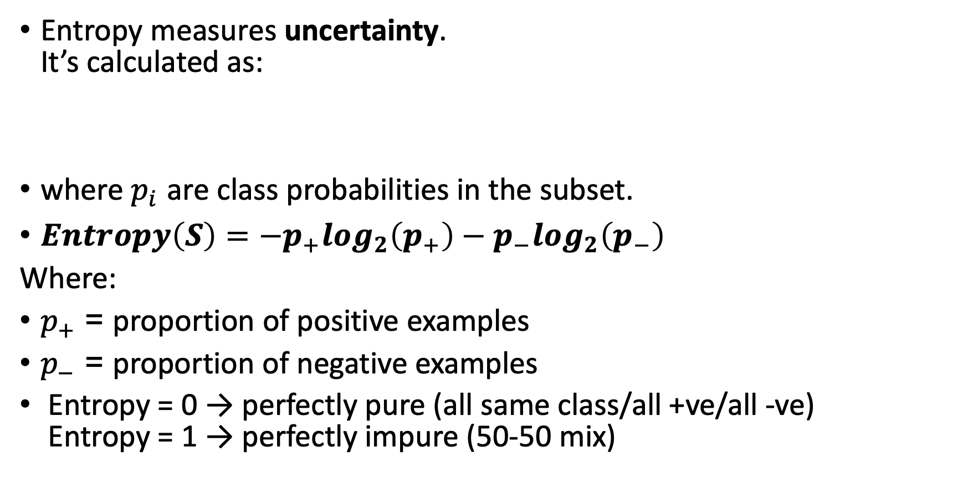
Entropy
Entropy measures uncertainty. It’s calculated as:
where $p_{i}$ are class probabilities in the subset.
$Entropy\left(S\right)=−p_{+}\log_{2}\left(p_{+}\right)−p_{−}\log_{2}\left(p_{−}\right)$
Where:
$p_{+}$ = proportion of positive examples
$p_{−}$ = proportion of negative examples
Entropy = 0 → perfectly pure (all same class/all +ve/all -ve) Entropy = 1 → perfectly impure (50-50 mix)

Slide 8
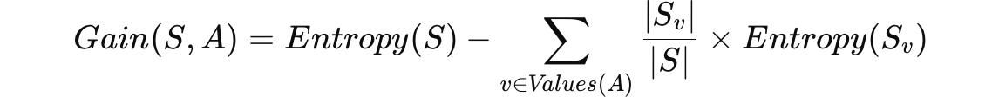
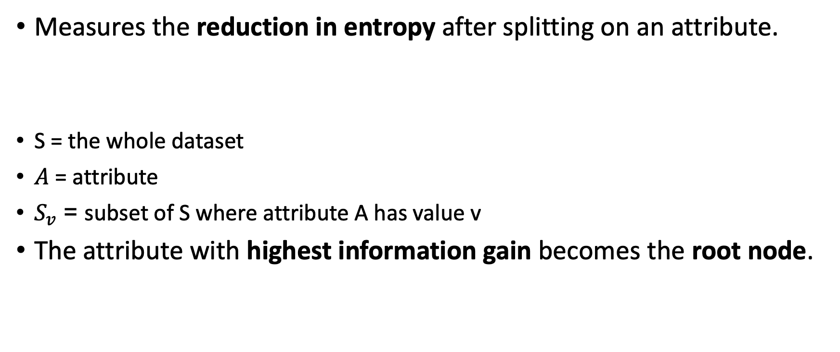
Information Gain
Measures the reduction in entropy after splitting on an attribute.
S = the whole dataset
$A$ = attribute
$S_{v}$ = subset of S where attribute A has value v
The attribute with highest information gain becomes the root node.

Slide 9
Example
Day | Outlook | Temperature | Humidity | Wind | Play Tennis
1 | Sunny | Hot | High | Weak | No
2 | Sunny | Hot | High | Strong | No
3 | Overcast | Hot | High | Weak | Yes
4 | Rain | Mild | High | Weak | Yes
5 | Rain | Cool | Normal | Weak | Yes
6 | Rain | Cool | Normal | Strong | No
7 | Overcast | Cool | Normal | Strong | Yes
8 | Sunny | Mild | High | Weak | No
9 | Sunny | Cool | Normal | Weak | Yes
10 | Rain | Mild | Normal | Weak | Yes

Slide 10
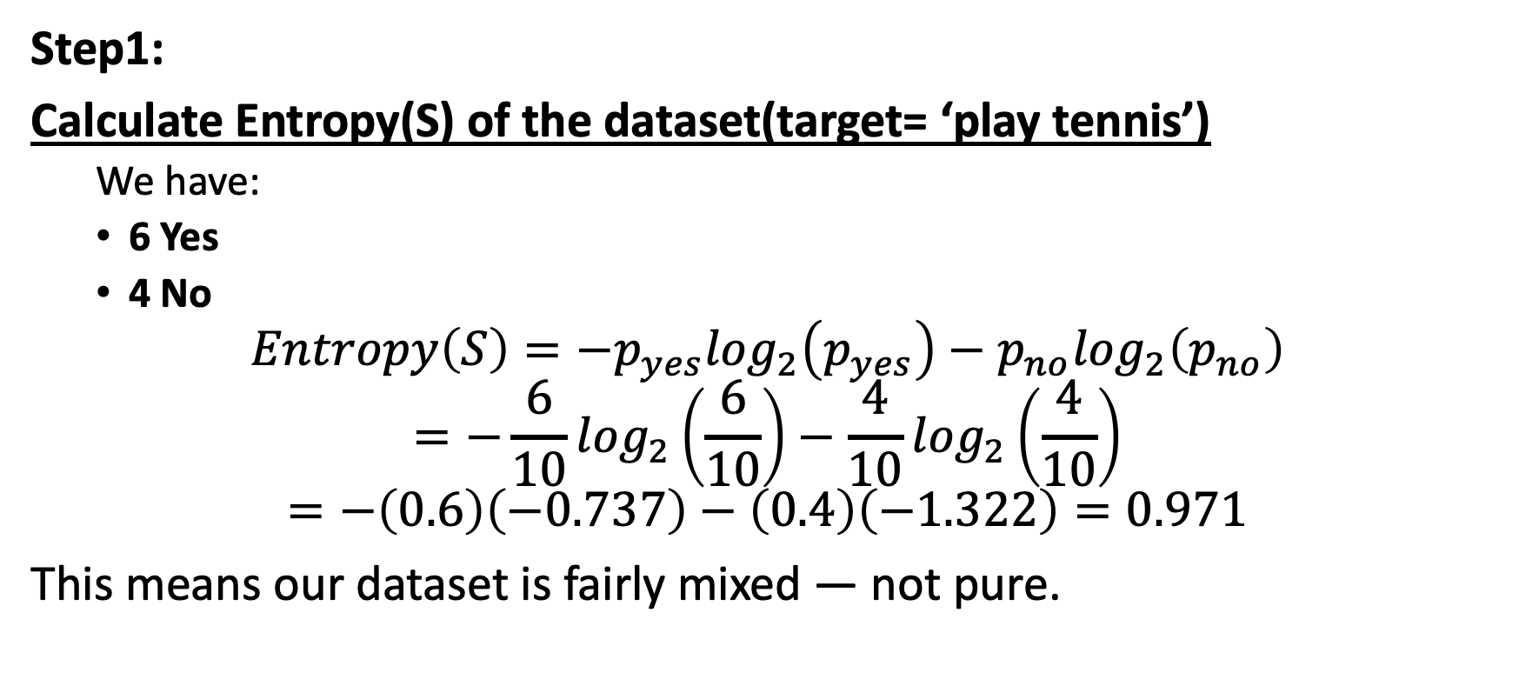
Find predictions using Decision tree
Step1:
Calculate Entropy(S) of the dataset(target= ‘play tennis’)
We have:
6 Yes
4 No
$$Entropy\left(S\right)=−p_{yes}\log_{2}\left(p_{yes}\right)−p_{no}\log_{2}\left(p_{no}\right)$$
$$=−\frac{6}{10}\log_{2}\left(\frac{6}{10}\right)−\frac{4}{10}\log_{2}\left(\frac{4}{10}\right)$$
$$=−\left(0.6\right)\left(−0.737\right)−\left(0.4\right)\left(−1.322\right)=0.971$$
This means our dataset is fairly mixed — not pure.

Slide 11
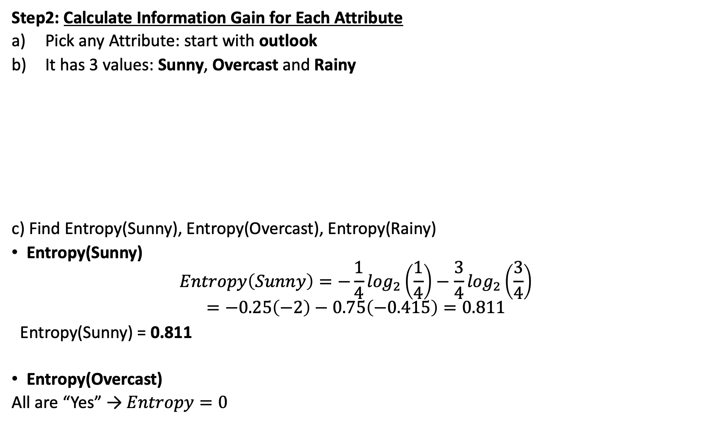
Step2: Calculate Information Gain for Each Attribute
Pick any Attribute: start with outlook
It has 3 values: Sunny, Overcast and Rainy
c) Find Entropy(Sunny), Entropy(Overcast), Entropy(Rainy)
Entropy(Sunny)
$$Entropy\left(Sunny\right)=−\frac{1}{4}\log_{2}\left(\frac{1}{4}\right)−\frac{3}{4}\log_{2}\left(\frac{3}{4}\right)$$
$$=−0.25\left(−2\right)−0.75\left(−0.415\right)=0.811$$
Entropy(Sunny) = 0.811
Entropy(Overcast)
All are “Yes” → $Entropy=0$
Attribute 1: Outlook
Outlook | Count | Yes | No
Sunny | 4 | 1 | 3
Overcast | 2 | 2 | 0
Rain | 4 | 3 | 1

Slide 12
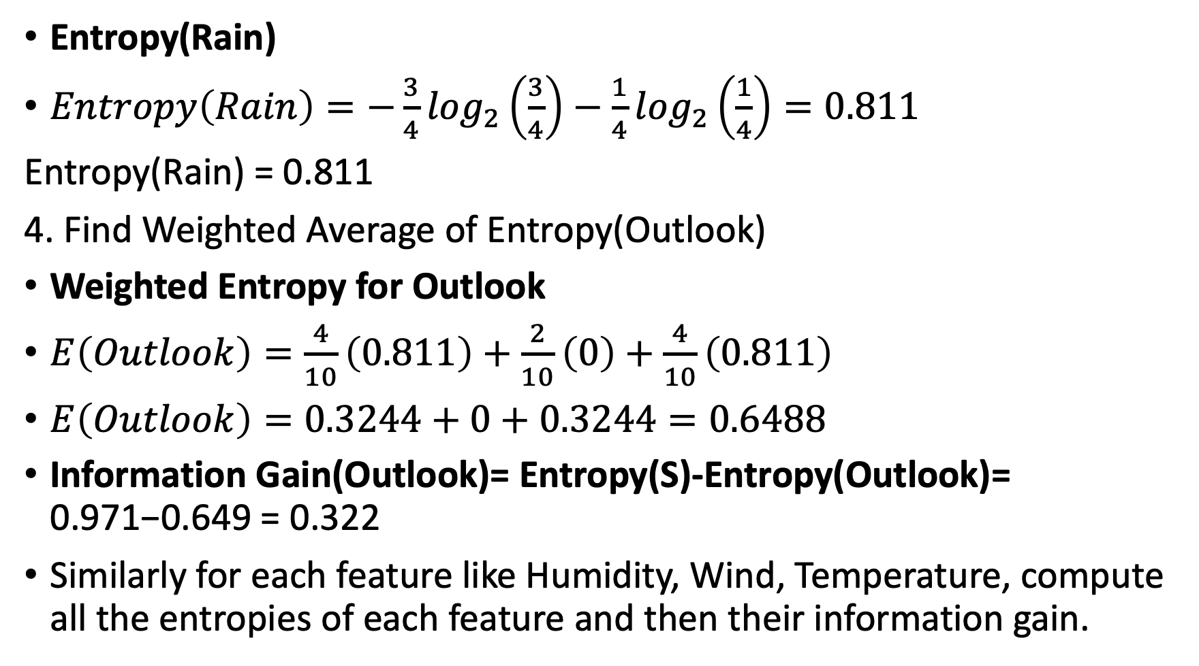
Entropy(Rain)
$Entropy\left(Rain\right)=−\frac{3}{4}\log_{2}\left(\frac{3}{4}\right)−\frac{1}{4}\log_{2}\left(\frac{1}{4}\right)=0.811$
Entropy(Rain) = 0.811
4. Find Weighted Average of Entropy(Outlook)
Weighted Entropy for Outlook
$E\left(Outlook\right)=\frac{4}{10}\left(0.811\right)+\frac{2}{10}\left(0\right)+\frac{4}{10}\left(0.811\right)$
$E\left(Outlook\right)=0.3244+0+0.3244=0.6488$
Information Gain(Outlook)= Entropy(S)-Entropy(Outlook)= 0.971−0.649 = 0.322
Similarly for each feature like Humidity, Wind, Temperature, compute all the entropies of each feature and then their information gain.

Slide 13
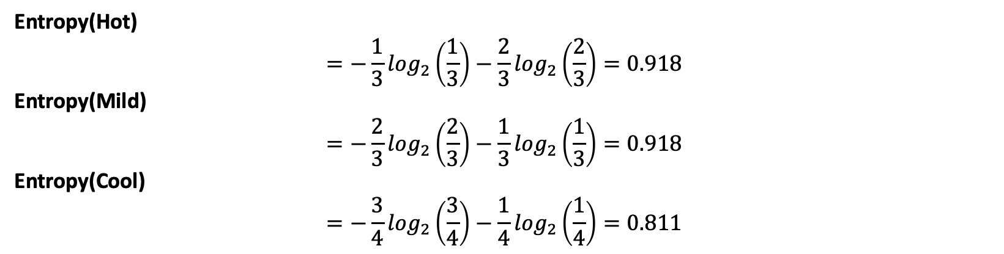
Attribute: Temperature
Temperature | Count | Yes | No
Hot | 3 | 1 | 2
Mild | 3 | 2 | 1
Cool | 4 | 3 | 1
Entropy(Hot)
$$=−\frac{1}{3}\log_{2}\left(\frac{1}{3}\right)−\frac{2}{3}\log_{2}\left(\frac{2}{3}\right)=0.918$$
Entropy(Mild)
$$=−\frac{2}{3}\log_{2}\left(\frac{2}{3}\right)−\frac{1}{3}\log_{2}\left(\frac{1}{3}\right)=0.918$$
Entropy(Cool)
$$=−\frac{3}{4}\log_{2}\left(\frac{3}{4}\right)−\frac{1}{4}\log_{2}\left(\frac{1}{4}\right)=0.811$$

Slide 14
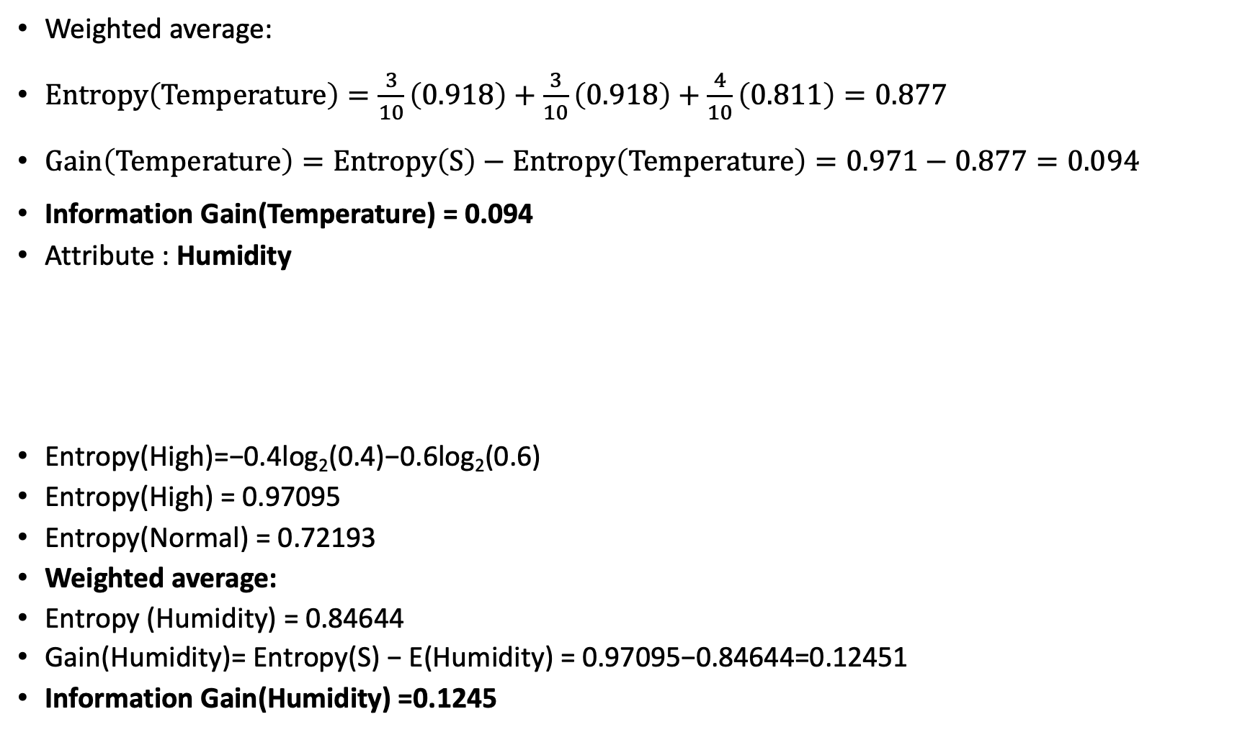
Weighted average:
$Entropy\left(Temperature\right)=\frac{3}{10}\left(0.918\right)+\frac{3}{10}\left(0.918\right)+\frac{4}{10}\left(0.811\right)=0.877$
$Gain\left(Temperature\right)=Entropy\left(S\right)−Entropy\left(Temperature\right)=0.971−0.877=0.094$
Information Gain(Temperature) = 0.094
Attribute : Humidity
Entropy(High)=−0.4log₂​(0.4)−0.6log₂​(0.6)
Entropy(High) = 0.97095
Entropy(Normal) = 0.72193
Weighted average:
Entropy (Humidity) = 0.84644
Gain(Humidity)= Entropy(S) − E(Humidity) = 0.97095−0.84644=0.12451
Information Gain(Humidity) =0.1245
Humidity | Count | Yes | No
High | 5 | 2 | 3
Normal | 5 | 4 | 1

Slide 15
Attribute | Information Gain
Outlook | 0.322
Humidity | 0.1245
Wind | 0.0955
temperature | 0.053
So Outlook is actually the best root split (highest information gain ≈ 0.322).
Notes:
We’ll now create 3 branches for:
Outlook = Sunny
Outlook = Overcast
Outlook = Rain

Slide 16
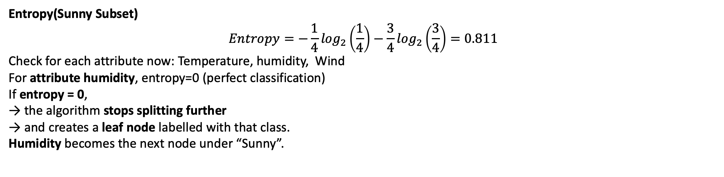
Branch 1: Outlook = Sunny
Subset of records where Outlook = Sunny:
Day | Outlook | Temperature | Humidity | Wind | Play Tennis
1 | Sunny | Hot | High | Weak | No
2 | Sunny | Hot | High | Strong | No
8 | Sunny | Mild | High | Weak | No
9 | Sunny | Cool | Normal | Weak | Yes
4 samples: 1 Yes, 3 No
We now calculate Information Gain within this subset to find the next best attribute.
Entropy(Sunny Subset)
$$Entropy=−\frac{1}{4}\log_{2}\left(\frac{1}{4}\right)−\frac{3}{4}\log_{2}\left(\frac{3}{4}\right)=0.811$$
Check for each attribute now: Temperature, humidity, Wind
For attribute humidity, entropy=0 (perfect classification)
If entropy = 0, → the algorithm stops splitting further → and creates a leaf node labelled with that class.
Humidity becomes the next node under “Sunny”.

Slide 17
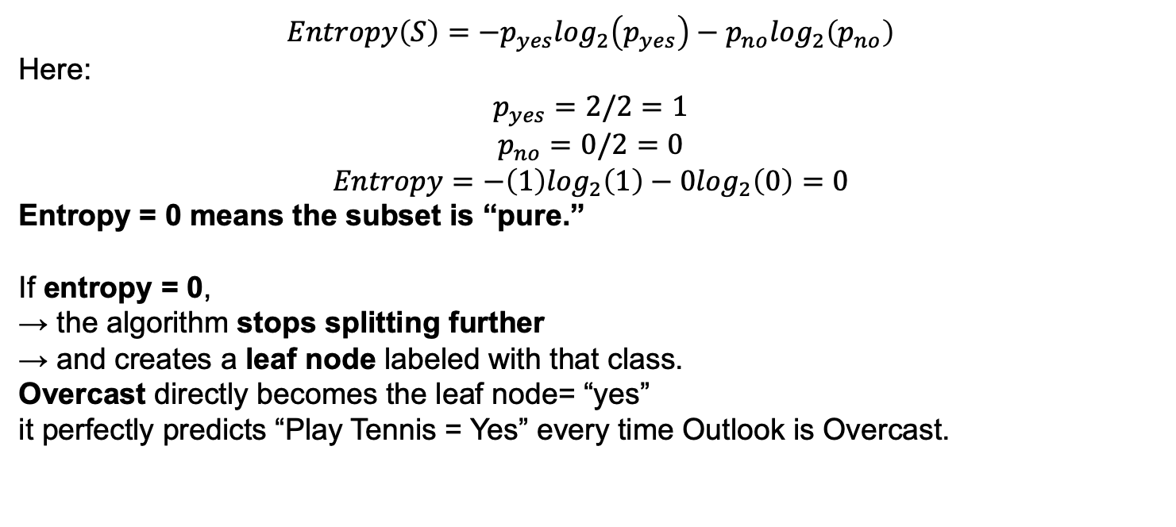
Branch 2: Outlook = Overcast
Day | Outlook | Temperature | Humidity | Wind | Play Tennis
3 | Overcast | Hot | High | Weak | Yes
7 | Overcast | Cool | Normal | Strong | Yes
$$Entropy\left(S\right)=−p_{yes}\log_{2}\left(p_{yes}\right)−p_{no}\log_{2}\left(p_{no}\right)$$
Here:
$$p_{yes}=2/2=1$$
$$p_{no}=0/2=0$$
$$Entropy=−\left(1\right)\log_{2}\left(1\right)−0\log_{2}\left(0\right)=0$$
Entropy = 0 means the subset is “pure.”
If entropy = 0, → the algorithm stops splitting further → and creates a leaf node labeled with that class.
Overcast directly becomes the leaf node= “yes”
it perfectly predicts “Play Tennis = Yes” every time Outlook is Overcast.

Slide 18
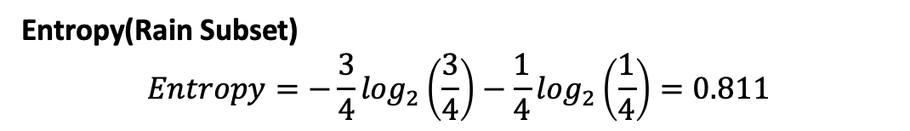
Branch 3:Outlook = Rain
Subset:
Day | Outlook | Temperature | Humidity | Wind | Play Tennis
4 | Rain | Mild | High | Weak | Yes
5 | Rain | Cool | Normal | Weak | Yes
6 | Rain | Cool | Normal | Strong | No
10 | Rain | Mild | Normal | Weak | Yes
Entropy(Rain Subset)
$$Entropy=−\frac{3}{4}\log_{2}\left(\frac{3}{4}\right)−\frac{1}{4}\log_{2}\left(\frac{1}{4}\right)=0.811$$
Check for each attribute now: Temperature, humidity, Wind
For Wind, Entropy=0 (perfect classification)
If entropy = 0, → the algorithm stops splitting further → and creates a leaf node labeled with that class
So, Wind becomes the node for “Rain”.

Slide 19
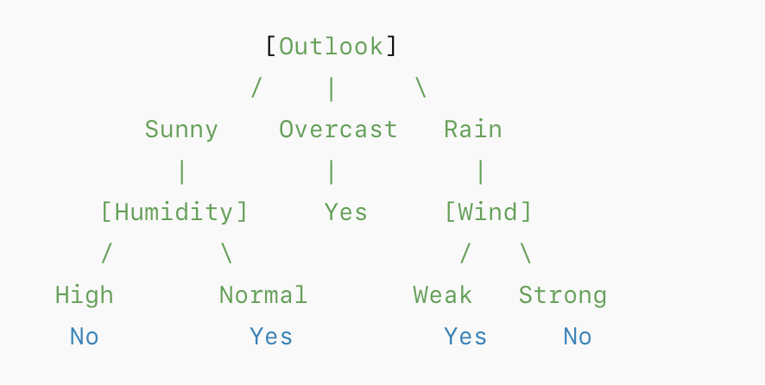
Final Decision tree
Classification Rules from the Tree
If Outlook = Overcast → Play = Yes
If Outlook = Sunny and Humidity = High → Play = No
If Outlook = Sunny and Humidity = Normal → Play = Yes
If Outlook = Rain and Wind = Weak → Play = Yes
If Outlook = Rain and Wind = Strong → Play = No

Slide 20
Practice Question
Person No. | A1 | A2 | A3 | Class (Target)
1 | Yes | Yes | Yes | Not Sick
2 | Yes | No | Yes | Sick
3 | No | No | Yes | Sick
4 | No | Yes | Yes | Not Sick
5 | No | Yes | No | Sick
Consider following training data for 5 persons. For binary classification of a person as sick or not sick create a decision tree model. Show all the steps.

Slide 21
Naïve Bayes Classifier
It’s a probabilistic machine learning algorithm used for classification tasks (i.e., predicting a category or label).
It’s based on Bayes’ Theorem, which calculates the probability of a class given some observed data.
Naïve Bayes assumes:
“Each feature contributes independently to the probability of a class”.
That’s why it’s called “naïve” — it assumes independence even if that’s not always true in real life.
Applications:
Spam filtering
Sentiment analysis
Document classification
Medical diagnosis
Notes:
In machine learning, features are the pieces of information we use to make a prediction.
Example: If you’re classifying an email as spam or not spam, your features could be:
$X_{1}$: whether the word “free” appears
$X_{2}$: whether the word “offer” appears
$X_{3}$: whether the word “meeting” appears
and your class (label) is:
$$Y=\text{Spam} \text{or} \text{Not} \text{Spam}$$
The probability that an email contains both “free” and “offer” (given it’s spam) is just the product of each individual probability.

Slide 22
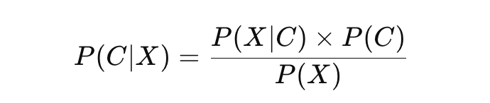
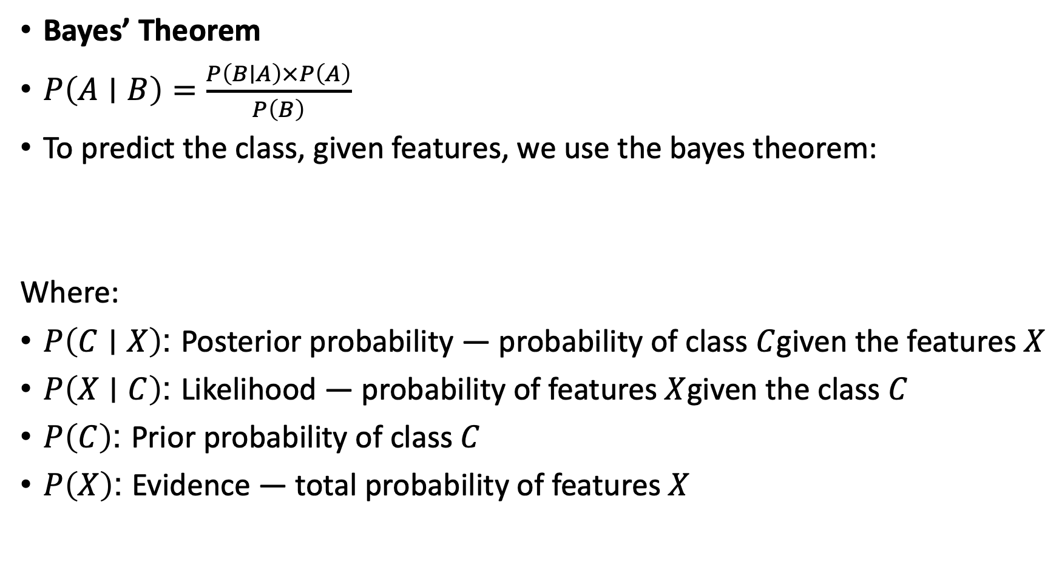
Bayes theorem
Bayes’ Theorem
$P\left(A∣B\right)=\frac{P\left(B∣A\right)×P\left(A\right)}{P\left(B\right)}$
To predict the class, given features, we use the bayes theorem:
Where:
$P\left(C∣X\right)$: Posterior probability — probability of class $C$given the features $X$
$P\left(X∣C\right)$: Likelihood — probability of features $X$given the class $C$
$P\left(C\right)$: Prior probability of class $C$
$P\left(X\right)$: Evidence — total probability of features $X$

Slide 23
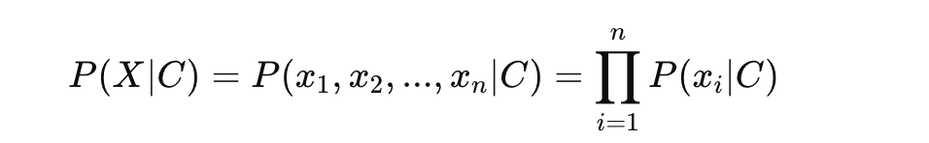
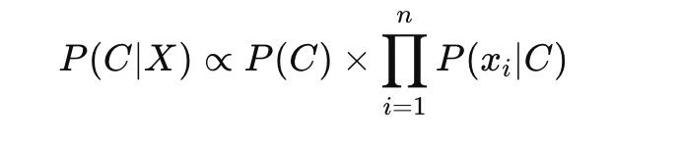
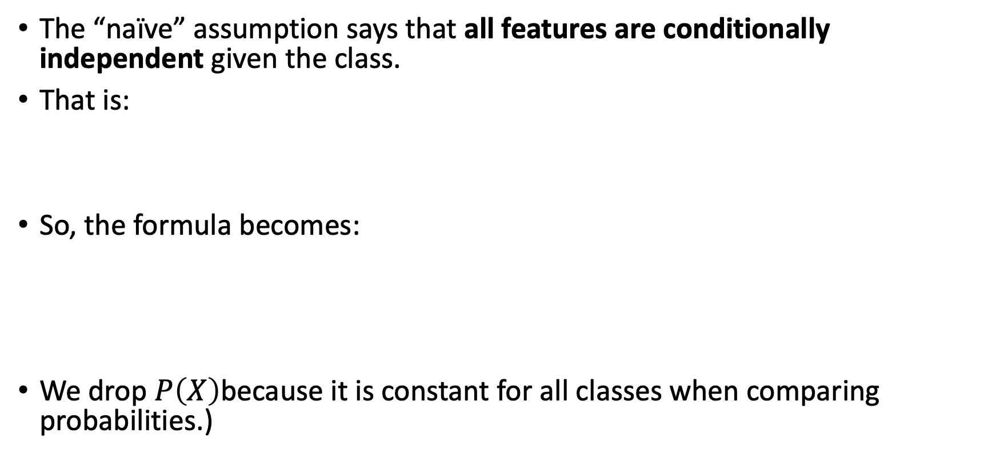
Naïve Bayes Classifier
The “naïve” assumption says that all features are conditionally independent given the class.
That is:
So, the formula becomes:
We drop $P\left(X\right)$because it is constant for all classes when comparing probabilities.)
Notes:
we mean that once we know the class, the features don’t depend on each other anymore.
To compute $P\left(X∣C\right)=P\left(x_{1} , x_{2} , x_{3}∣C\right)$, we’d need to know how these features depend on each other.
Maybe “Free” and “Offer” often appear together — that makes things complicated!
We’d have to calculate joint probabilities like $P\left(x_{1} , x_{2} , x_{3}∣C\right)$, which are very hard to estimate from data (especially when you have many features).
The probability of a class $C$given the features $X=\left(x_{1} , x_{2} , . , ..x_{n}\right)$is proportional (∝) to the prior probability of that class $P\left(C\right)$, multiplied by the product of the probabilities of each feature $x_{i}$given that class.
We drop $P\left(X\right)$because:
$P\left(X\right)$is the same for all classes.
Let’s say we are comparing two classes:
$$P\left(C_{1}∣X\right)=\frac{P\left(X∣C_{1}\right)P\left(C_{1}\right)}{P\left(X\right)}$$
$$P\left(C_{2}∣X\right)=\frac{P\left(X∣C_{2}\right)P\left(C_{2}\right)}{P\left(X\right)}$$
Now — when we classify, we only care which class has the higher probability.
Since the denominator $P\left(X\right)$is the same for both (because it doesn’t depend on $C$), it does not affect which one is larger.

Slide 24
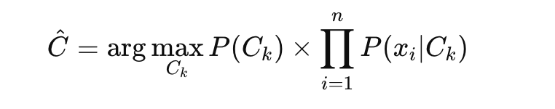
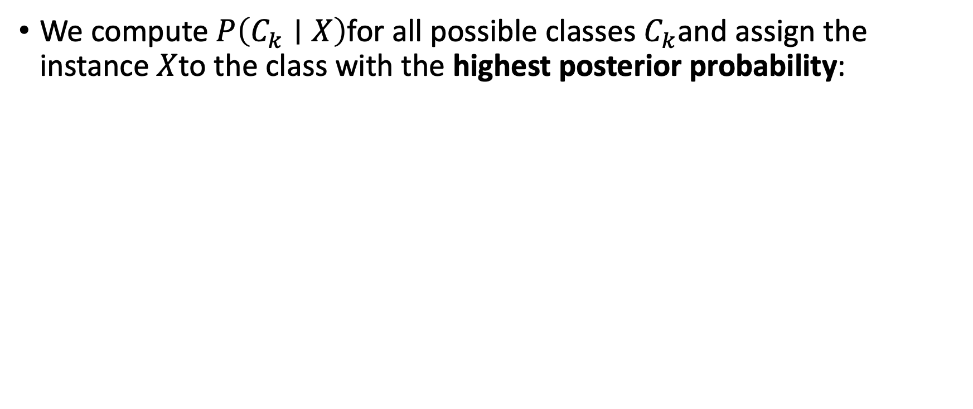
Naïve Bayes Classifier
We compute $P\left(C_{k}∣X\right)$for all possible classes $C_{k}$and assign the instance $X$to the class with the highest posterior probability:
Let’s say we want to predict whether a person buys a computer (Yes/No) based on two attributes: Age and Income.
Age | Income | Buys Computer
Young | High | No
Young | Low | Yes
Old | High | Yes
We want to predict for a new person: (Age = Young, Income = High).

Slide 25
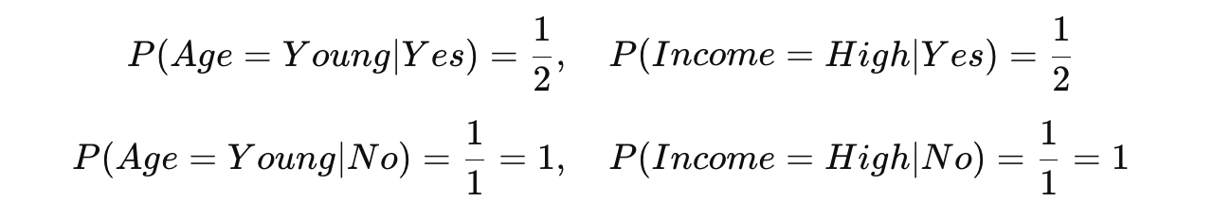
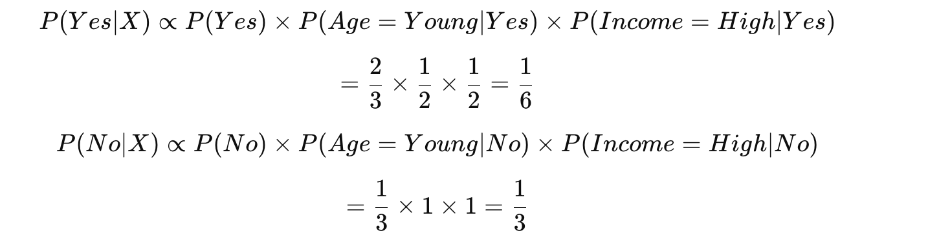
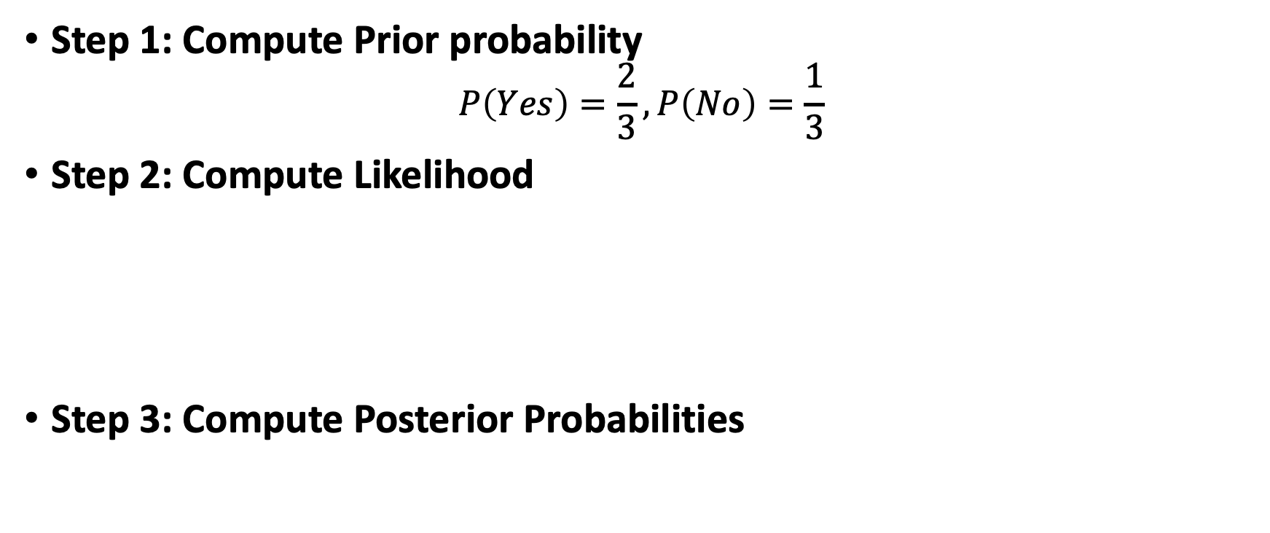
Step 1: Compute Prior probability
$$P\left(Yes\right)=\frac{2}{3}, P\left(No\right)=\frac{1}{3}$$
Step 2: Compute Likelihood
Step 3: Compute Posterior Probabilities
Since $P\left(No∣X\right)>P\left(Yes∣X\right)$, we predict “No”.

Slide 26
Example
We want to predict whether to Play Tennis (Yes/No) based on given weather conditions.
Suppose the new day has these conditions: Outlook = Sunny, Temperature = Cool, Humidity = High, Wind = Strong Should we play tennis?

Slide 27
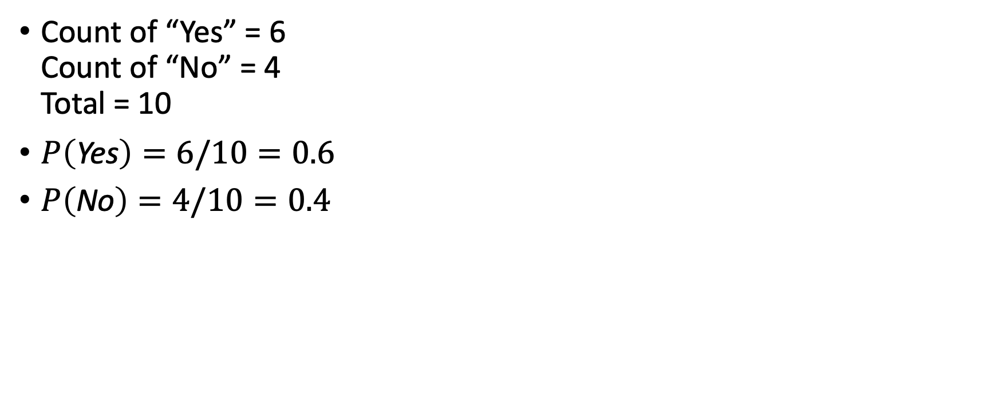
Step 1: Compute Prior probability
Count of “Yes” = 6 Count of “No” = 4 Total = 10
$P\left(\text{Yes}\right)=6/10=0.6$
$P\left(\text{No}\right)=4/10=0.4$

Slide 28
Step 2: Compute likelihood probability
Outlook
P(Sunny∣Yes)=1/6
P(Overcast∣Yes)=2/6
P(Rain∣Yes)=3/6
P(Sunny∣No)=3/4
P(Overcast∣No)=0/4
P(Rain∣No)=1/4
Temperature
P(Hot∣Yes)=1/6, P(Mild∣Yes)=2/6, P(Cool∣Yes)=3/6
P(Hot∣No)=2/4, P(Mild∣No)=1/4, P(Cool∣No)=1/4
Humidity
P(High∣Yes)=2/6, P(Normal∣Yes)=4/6
P(High∣No)=3/4, P(Normal∣No)=1/4
Wind
P(Weak∣Yes)=5/6, P(Strong∣Yes)=1/6
P(Weak∣No)=2/4, P(Strong∣No)=2/4

Slide 29
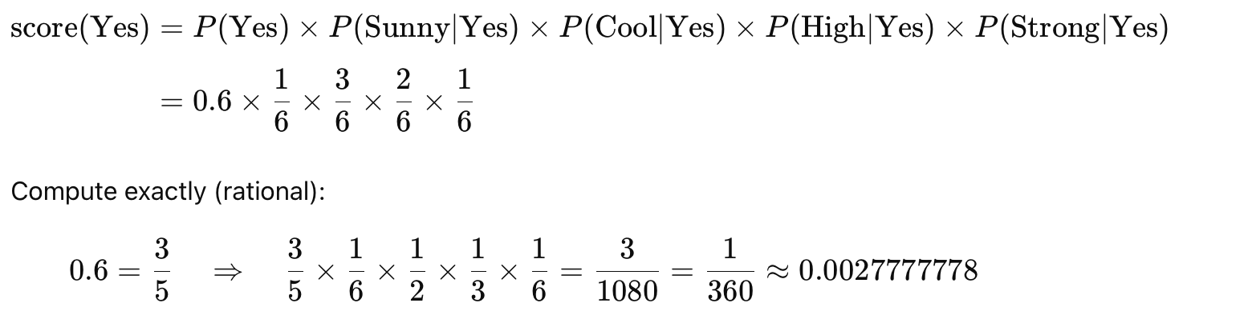
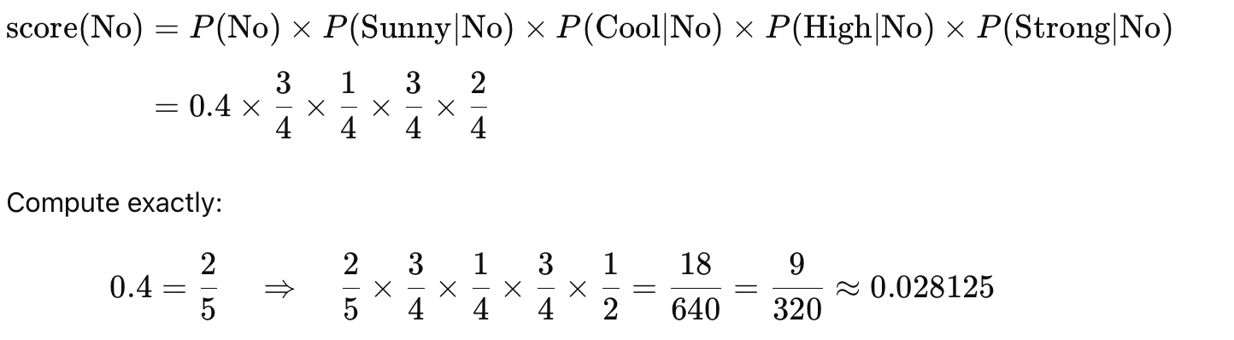
Step3: Calculate Posterior Probabilities

Slide 30
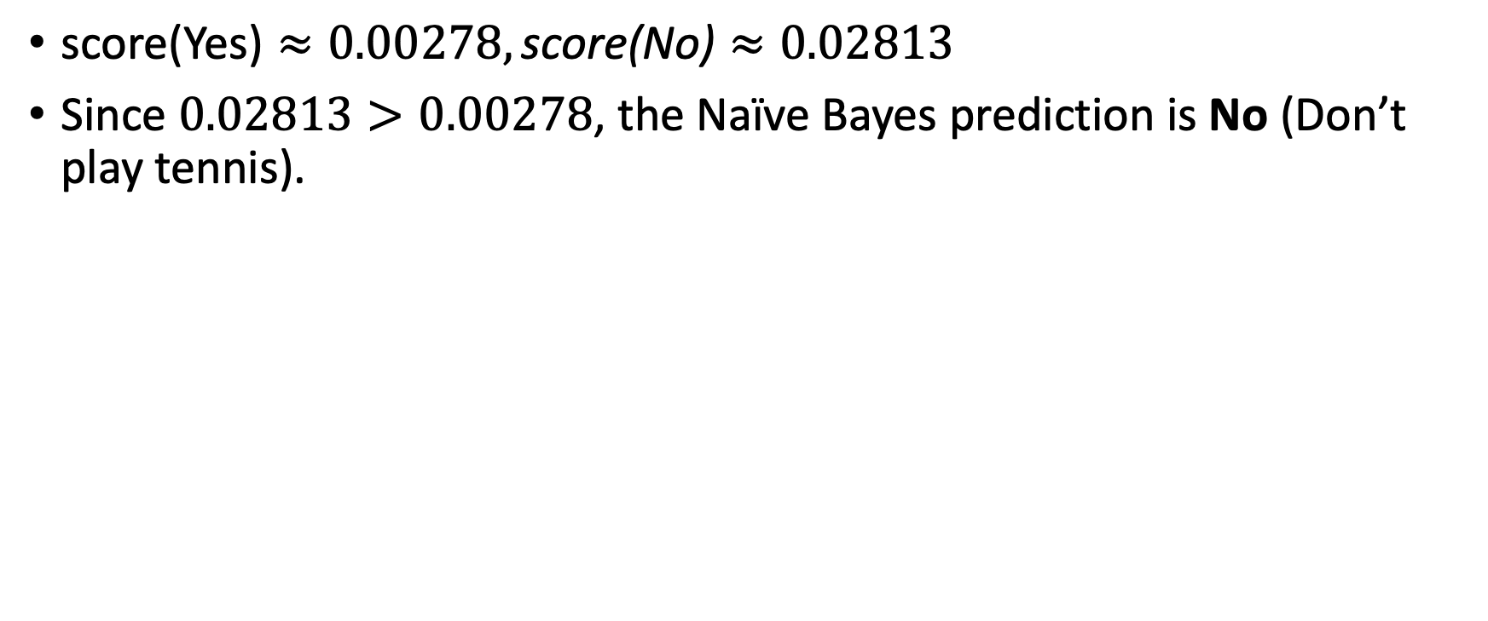
Decision
$\text{score}\text{(}\text{Yes}\text{)}≈0.00278, \text{score}\text{(}\text{No}\text{)}≈0.02813$
Since $0.02813>0.00278$, the Naïve Bayes prediction is No (Don’t play tennis).

Slide 31
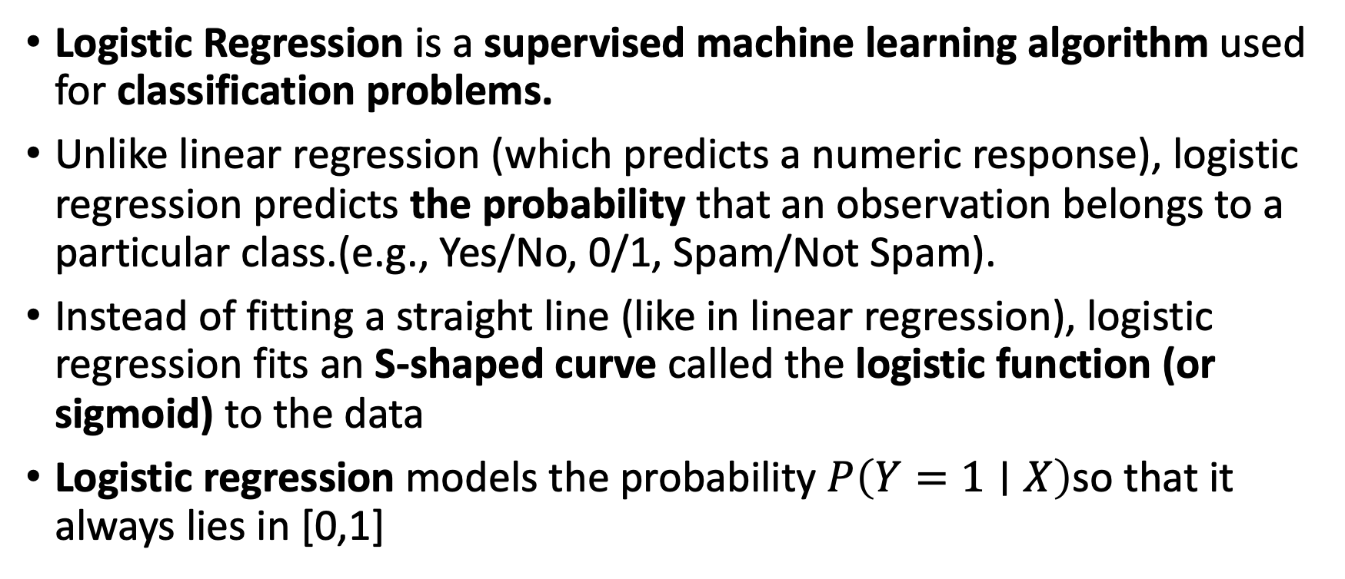
Logistic Regression
Logistic Regression is a supervised machine learning algorithm used for classification problems.
Unlike linear regression (which predicts a numeric response), logistic regression predicts the probability that an observation belongs to a particular class.(e.g., Yes/No, 0/1, Spam/Not Spam).
Instead of fitting a straight line (like in linear regression), logistic regression fits an S-shaped curve called the logistic function (or sigmoid) to the data
Logistic regression models the probability $P\left(Y=1∣X\right)$so that it always lies in [0,1]
Notes:
A qualitative (categorical) response variable represents categories or labels, not numeric quantities — e.g.,
These have no inherent numeric relationship or ordering.
Linear regression, however, assumes that:
The response variable $Y$is numeric,
Differences between values of $Y$are meaningful and consistent (e.g., the difference between 2 and 3 is the same as between 3 and 4).
If we force a numeric code like:
$Y=\left\{\begin{matrix}1, & \text{if} \text{stroke} \\ 2, & \text{if} \text{drug} \text{overdose} \\ 3, & \text{if} \text{epileptic} \text{seizure}\end{matrix}\right.$
then linear regression treats these as ordered values:
$\text{drug} \text{overdose} \text{is}\text{ “}\text{between}\text{” }\text{stroke} \text{and} \text{seizure}.$
This implies that:
The “distance” (difference) between stroke and overdose = difference between overdose and seizure, which is arbitrary and false.
If you relabel the categories differently (e.g., stroke = 3, overdose = 1, seizure = 2), you get a different regression model and different predictions — a clear sign that the model is not invariant to label coding.
So, for multi-class qualitative outcomes, linear regression gives inconsistent and meaningless results.

Slide 32
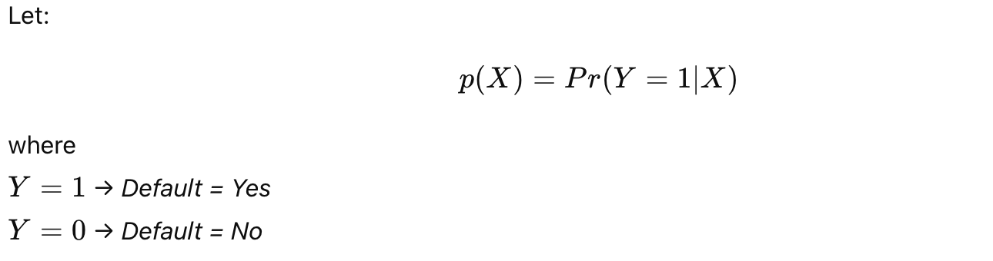
Logistic Regression
Example: Default Dataset
Response (Y): default — takes two values:
Yes → the customer defaults on a credit card payment
No → the customer does not default
Predictor (X): one or more quantitative variables (e.g., balance, income, student status).
We want to model the probability of an event (e.g., default = Yes) given predictors (e.g., balance).
Notes:
If we try to use a linear model:
$$p\left(X\right)=β_{0}+β_{1}X$$
then:
$p\left(X\right)$ can take on any real value.
This means predicted probabilities may be negative or greater than 1, which are nonsensical for probabilities
In the Default data:
For very small balances → predicted $p\left(X\right)<0$
For very large balances → predicted $p\left(X\right)>1$
Hence, linear regression is inappropriate for modeling probabilities of binary outcomes.

Slide 33
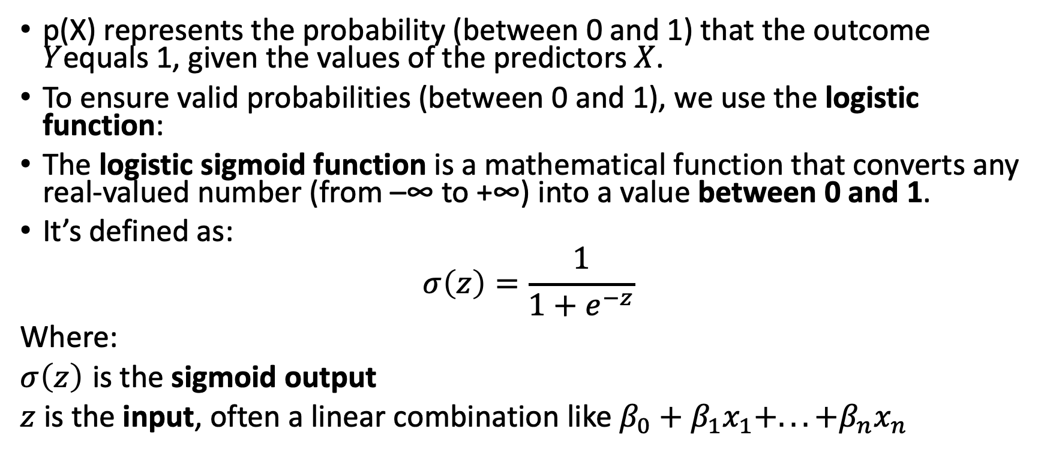
Logistic Regression
p(X) represents the probability (between 0 and 1) that the outcome $Y$equals 1, given the values of the predictors $X$.
To ensure valid probabilities (between 0 and 1), we use the logistic function:
The logistic sigmoid function is a mathematical function that converts any real-valued number (from –∞ to +∞) into a value between 0 and 1.
It’s defined as:
$$σ\left(z\right)=\frac{1}{1+e^{−z}}$$
Where:
$σ\left(z\right)$ is the sigmoid output
$z$ is the input, often a linear combination like $β_{0}+β_{1}x_{1}+...+β_{n}x_{n}$
Notes:
This means “the probability that the response variable $Y$equals 1, given the predictor(s) $X$.”
$Y=1$usually represents a specific event or class — for example,
“Yes” in default = Yes/No,
“disease present” in a medical diagnosis,
“spam” in an email classifier.
$X$represents one or more input features or predictors, such as balance, income, or age.
So, this term expresses:
Given the predictor values $X$, how likely is it that the event $Y=1$occurs?
p(X) is just a short-hand notation for that probability.
It’s a function that maps values of $X$to probabilities between 0 and 1.
For example:
$$p\left(X\right)=\left\{\begin{matrix}0.1 & \text{if} \text{balance}\text{ = 500} \\ 0.8 & \text{if} \text{balance}\text{ = 2000}\end{matrix}\right.$$
means a person with balance = 2000 has a higher chance of defaulting.

Slide 34
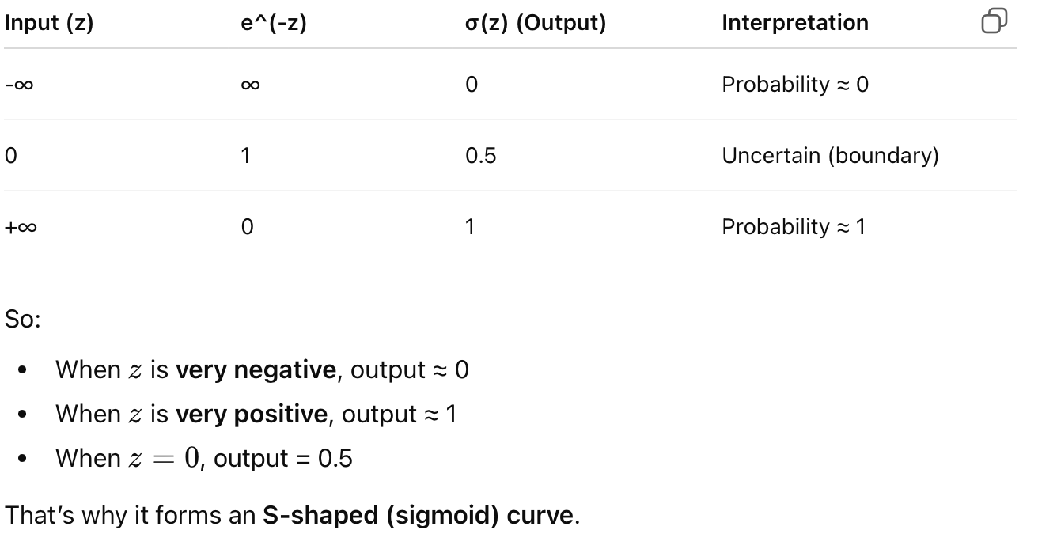
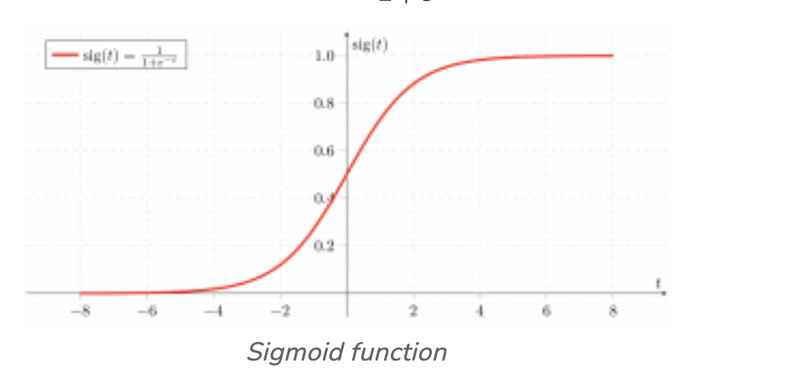
Logistic Regression
The sigmoid function helps transform the linear output (which can be any number) into a probability value (between 0 and 1). This is essential because classification problems deal with probabilities — e.g.
“What’s the probability that the email is spam?”
Notes:
Decision Boundary: If $P\left(y=1∣x\right)≥0.5$ → Class = 1 If $P\left(y=1∣x\right)<0.5$ → Class = 0

Slide 35
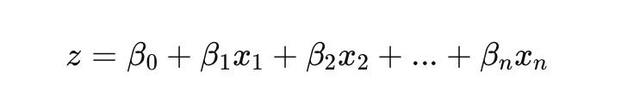
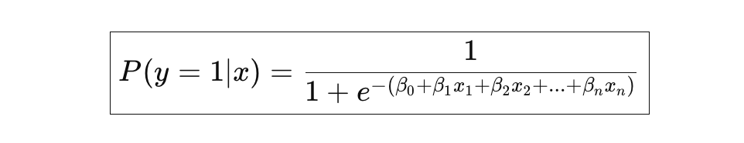
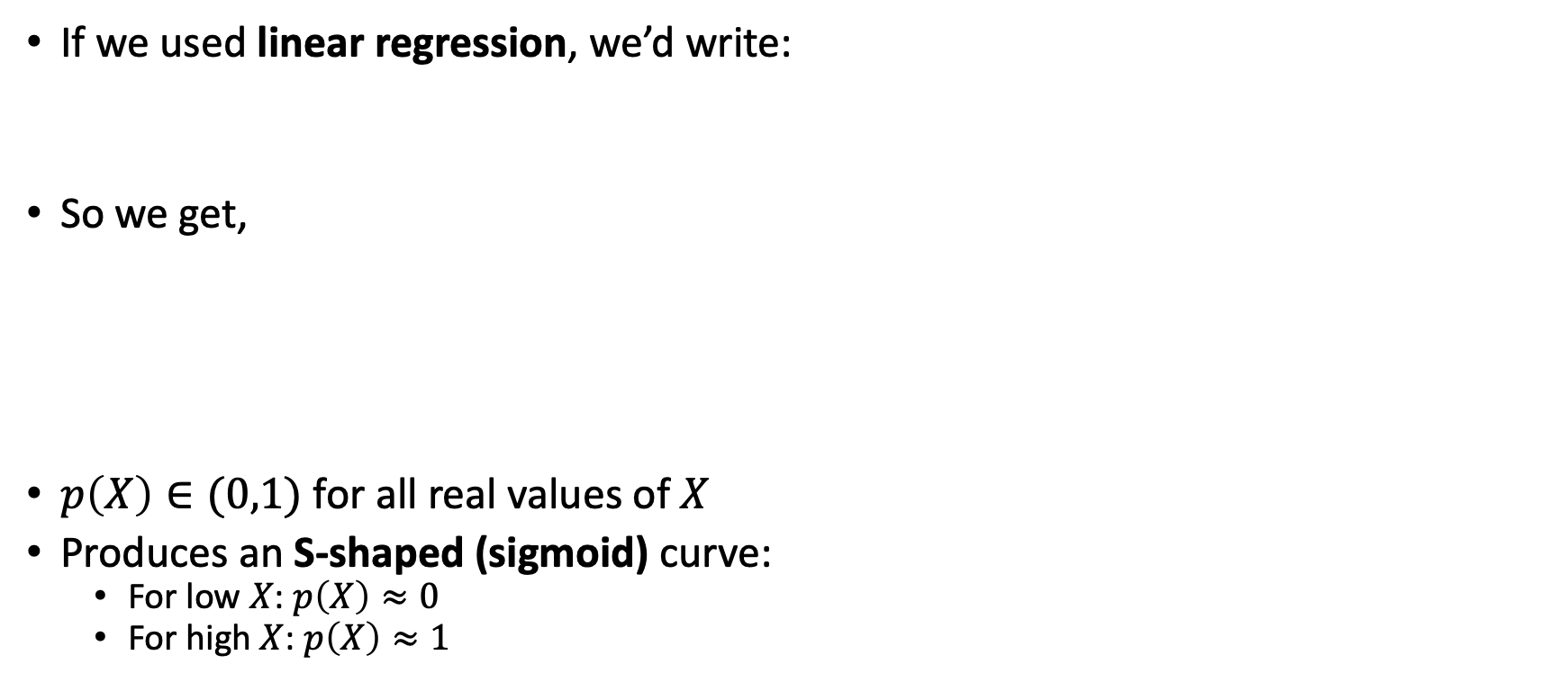
Logistic Regression
If we used linear regression, we’d write:
So we get,
$p\left(X\right)∈(0,1)$ for all real values of $X$
Produces an S-shaped (sigmoid) curve:
For low $X$: $p\left(X\right)≈0$
For high $X$: $p\left(X\right)≈1$
Notes:
But there’s a problem 👇 👉 The right-hand side can take any real value, even <0 or >1 — which makes no sense for a probability (since probability ∈ [0,1]).
So we need a way to squash this linear combination into the [0,1] range.

Slide 36
Applications
Healthcare (Predict whether a patient has a disease (Yes/No))
Finance (Predict loan/credit card default (default / no default))
Marketing(Predict whether a customer will buy a product (purchase / not purchase), predict churn (will customer leave / stay)
Software Quality(Predict if a software module is faulty/non-faulty)

Slide 37
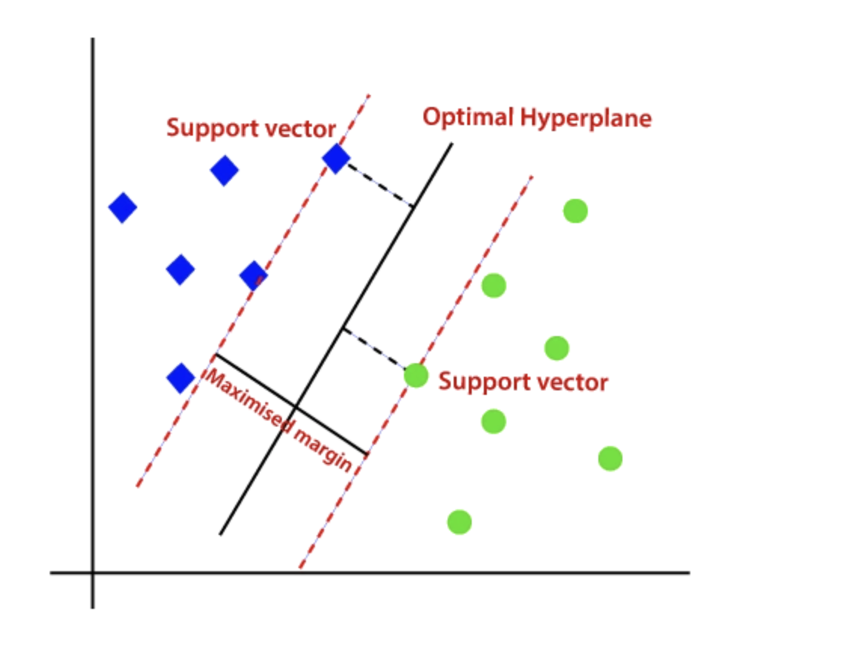
Support Vector Machine
It is a supervised machine learning algorithm used for classification and regression tasks.
Its goal is to find the best separating boundary (hyperplane) between data points of different classes by maximizing the margin between the two classes.
This margin is the distance from the hyperplane to the nearest data points (support vectors) on each side. The larger the margin the better the model performs on new and unseen data.
Notes:
Imagine we have two types of points on a graph:
🔵 Blue points (Class A)
🔴 Red points (Class B)
We want a line (in 2D) or plane (in higher dimensions) that separates these two classes as well as possible.
There can be many possible lines, but SVM finds the one that gives the maximum margin — meaning the widest possible gap between both classes.

Slide 38
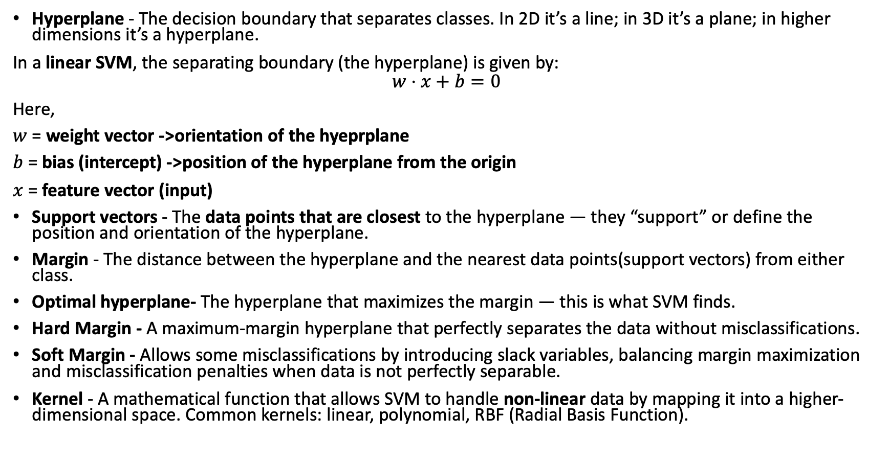
Key Terms
Hyperplane - The decision boundary that separates classes. In 2D it’s a line; in 3D it’s a plane; in higher dimensions it’s a hyperplane.
In a linear SVM, the separating boundary (the hyperplane) is given by:
$$w⋅x+b=0$$
Here,
$w$ = weight vector ->orientation of the hyeprplane
$b$ = bias (intercept) ->position of the hyperplane from the origin
$x$ = feature vector (input)
Support vectors - The data points that are closest to the hyperplane — they “support” or define the position and orientation of the hyperplane.
Margin - The distance between the hyperplane and the nearest data points(support vectors) from either class.
Optimal hyperplane- The hyperplane that maximizes the margin — this is what SVM finds.
Hard Margin - A maximum-margin hyperplane that perfectly separates the data without misclassifications.
Soft Margin - Allows some misclassifications by introducing slack variables, balancing margin maximization and misclassification penalties when data is not perfectly separable.
Kernel - A mathematical function that allows SVM to handle non-linear data by mapping it into a higher-dimensional space. Common kernels: linear, polynomial, RBF (Radial Basis Function).

Slide 39
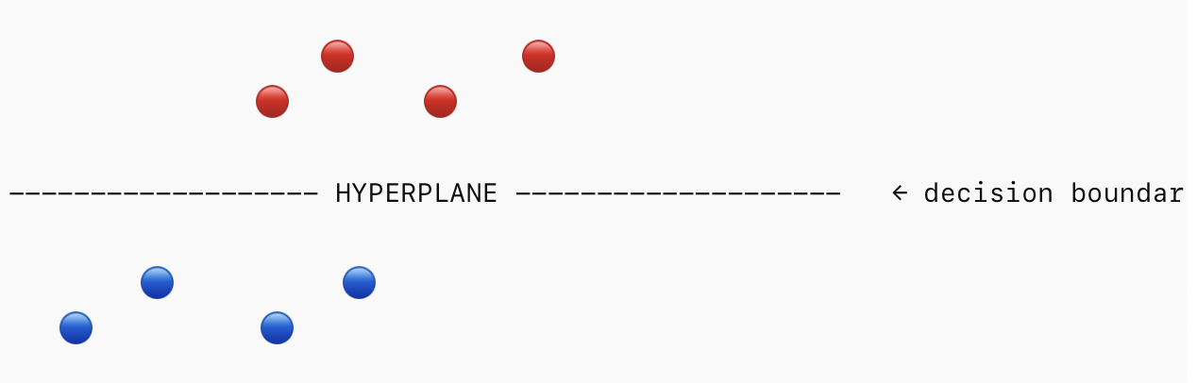
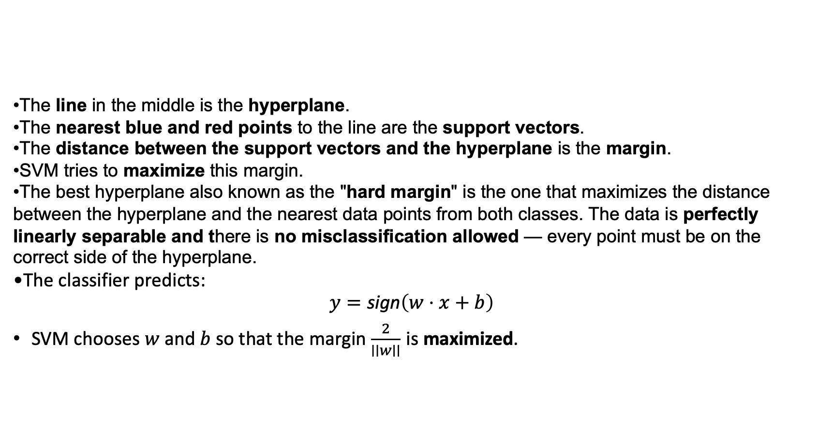
How SVM algorithm works
The line in the middle is the hyperplane.
The nearest blue and red points to the line are the support vectors.
The distance between the support vectors and the hyperplane is the margin.
SVM tries to maximize this margin.
The best hyperplane also known as the "hard margin" is the one that maximizes the distance between the hyperplane and the nearest data points from both classes. The data is perfectly linearly separable and there is no misclassification allowed — every point must be on the correct side of the hyperplane.
The classifier predicts:
$$y=\text{sign}\left(w⋅x+b\right)$$
SVM chooses $w$ and $b$ so that the margin $\frac{2}{∣∣w∣∣}$ is maximized.
Notes:
What if a blue point lies in the boundary of red class?
The SVM algorithm has the characteristics to ignore the outlier and finds the best hyperplane that maximizes the margin. SVM is robust to outliers.

Slide 40
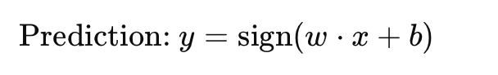
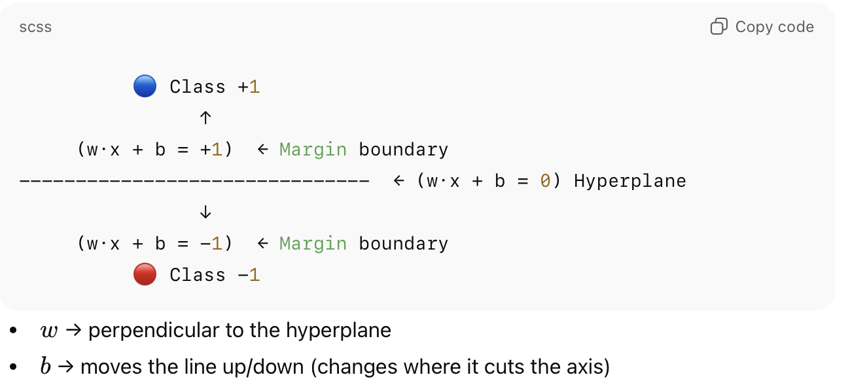
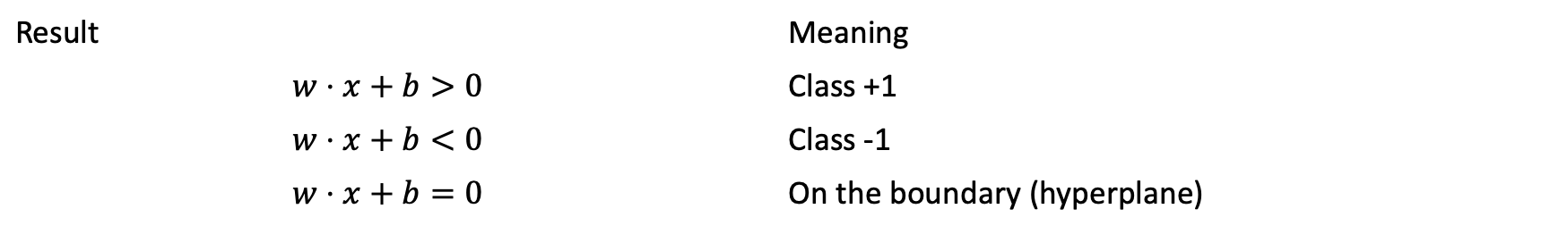
SVM uses the sign of $\left(w⋅x+b\right)$ to classify:
Result | Meaning
$$w⋅x+b>0$$ | Class +1
$$w⋅x+b<0$$ | Class -1
$$w⋅x+b=0$$ | On the boundary (hyperplane)

Slide 41
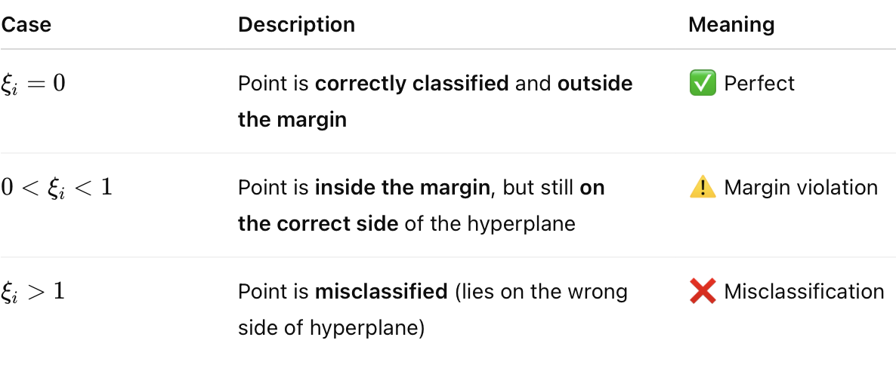
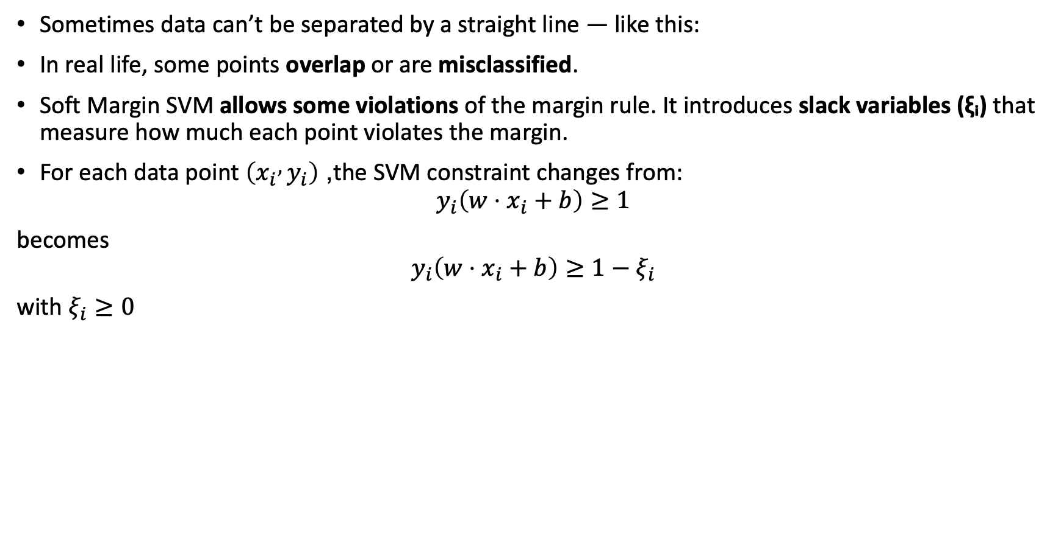
When Data Isn’t Linearly Separable
Sometimes data can’t be separated by a straight line — like this:
In real life, some points overlap or are misclassified.
Soft Margin SVM allows some violations of the margin rule. It introduces slack variables (ξᵢ) that measure how much each point violates the margin.
For each data point $\left(x_{i} , y_{i}\right)$, the SVM constraint changes from:
$$y_{i}\left(w⋅x_{i}+b\right)≥1$$
becomes
$$y_{i}\left(w⋅x_{i}+b\right)≥1−ξ_{i}$$
with $ξ_{i}≥0$

Slide 42
Kernel Trick
In this case, SVM uses Kernel Trick — it transforms data into a higher-dimensional space where a separating hyperplane can be found. It handles non-linear classification problems. By applying a kernel function, SVM transforms the data points into a higher-dimensional space where they become linearly separable.
Example:
Linear Kernel → When the data is perfectly linearly separable only then we can use Linear SVM. Perfectly linearly separable means that the data points can be classified into 2 classes by using a single straight line(if 2D)straight line.
Polynomial Kernel → When the relationship between features and target seems nonlinear but smooth and polynomial-like.
RBF Kernel -> When the relationship between features and output is highly nonlinear or unknown.

Slide 43
How to choose which algorithm to use?
If your data is... | Try using...
Linearly separable, simple | Logistic Regression
Non-linear but small dataset | SVM (with RBF kernel)
Large, interpretable, mixed data types | Decision Tree
Text or categorical, fast prediction needed | Naive Bayes

Slide 44
KNN classifier
It is a simple, non-parametric, and instance-based machine learning algorithm used for classification and regression.
It is based on the idea of similarity.
“If something looks similar to other things, it probably belongs to the same group”
So when you want to classify a new data point, KNN looks at its ‘k’ nearest neighbors (the closest data points in the training set) and assigns the most common class among those neighbors.
No training phase is required (lazy learning)
It works well with small datasets
Applications: Handwriting recognition (e.g., digits 0–9), Recommendation systems (based on similarity), Anomaly detection, Medical diagnosis (based on similar patient profiles)

Slide 45
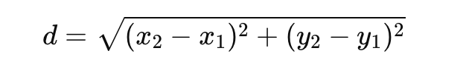
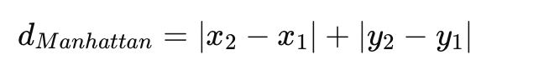
Steps in KNN algorithm
Step1 : Choose K — the number of neighbors to consider (like 3, 5, or 7).
Step2: Calculate distance → between the new data point and all points in the training data.
Common distance metrics:
Euclidean distance -This is the straight-line distance between two points
Manhattan distance(L1 distance) - the distance between two points is the sum of the absolute differences of their coordinates.
Minkowski distance- This is the generalized version of both Euclidean and Manhattan distance.
Notes:
Euclidean distance: Use it when Your features are continuous (like height, weight, temperature, etc.)
All features are on the same scale (e.g., after standardization or normalization)
Don’t use it when the data contains categorical or binary features (Euclidean doesn’t handle them well)
Manhattan distance: Use it when your features are discrete or sparse, such as text data or count-based features
You have high-dimensional data — it’s more stable than Euclidean in those cases, Your data is strongly correlated across features
Minkowski distance- You want a flexible general distance metric.Used when experimenting with KNN hyperparameter tuning to optimize model performance.

Slide 46
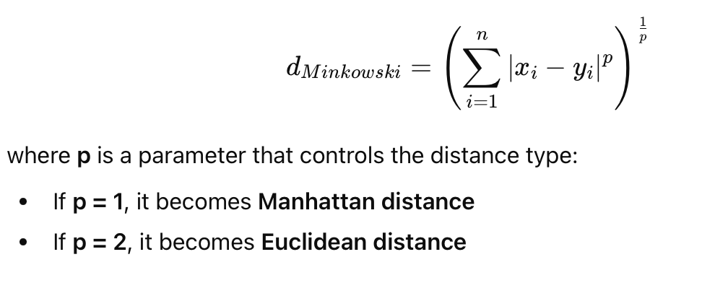
Step3: Find K-nearest neighbours- the K points with the smallest distances.
Step4: Vote → count the classes of these neighbors.
Step5: Assign that class to the new data point.

Slide 47
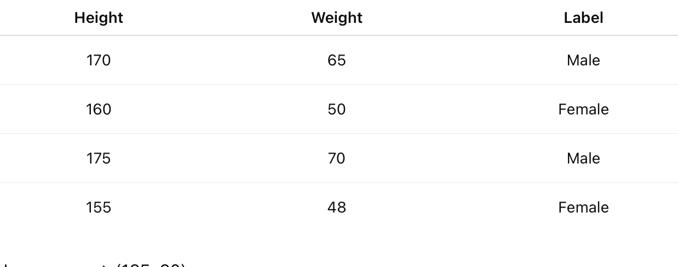
Example
New person → (165, 60), What will be the label for this new person

Slide 48
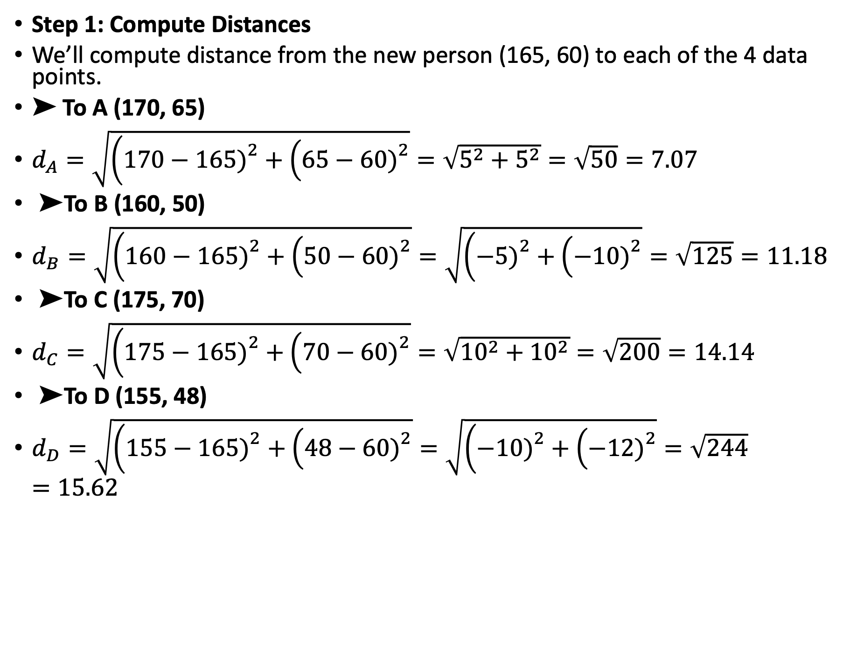
Step 1: Compute Distances
We’ll compute distance from the new person (165, 60) to each of the 4 data points.
➤ To A (170, 65)
$d_{A}=\sqrt{\left(170−165{\left.)\right.}^{2}+\left(65−60{\left.)\right.}^{2}\right.\right.}=\sqrt{5^{2}+5^{2}}=\sqrt{50}=7.07$
➤ To B (160, 50)
$d_{B}=\sqrt{\left(160−165{\left.)\right.}^{2}+\left(50−60{\left.)\right.}^{2}\right.\right.}=\sqrt{\left(−5{\left.)\right.}^{2}+\left(−10{\left.)\right.}^{2}\right.\right.}=\sqrt{125}=11.18$
➤ To C (175, 70)
$d_{C}=\sqrt{\left(175−165{\left.)\right.}^{2}+\left(70−60{\left.)\right.}^{2}\right.\right.}=\sqrt{{10}^{2}+{10}^{2}}=\sqrt{200}=14.14$
➤ To D (155, 48)
$d_{D}=\sqrt{\left(155−165{\left.)\right.}^{2}+\left(48−60{\left.)\right.}^{2}\right.\right.}=\sqrt{\left(−10{\left.)\right.}^{2}+\left(−12{\left.)\right.}^{2}\right.\right.}=\sqrt{244}=15.62$

Slide 49
Step 2: Sort by Distance
Neighbor | Distance | Label
A | 7.07 | Male
B | 11.18 | Female
C | 14.14 | Male
D | 15.62 | Female
Step 3: Choose K
Let’s choose K = 3 (the 3 nearest neighbors).
So, the nearest 3 are:
A (Male)
B (Female)
C (Male)
Step 4: Majority Vote
Among these 3:
Male = 2
Female = 1
✅ Predicted class = Male

Slide 50
Artificial Neural Networks
An Artificial Neural Network is a computational model inspired by how the human brain processes information. Just like the brain uses neurons to process data and make decisions, ANNs use artificial neurons to analyze data, identify patterns and make predictions
These networks consist of layers of interconnected neurons that work together to solve complex problems.
The key idea is that ANNs can "learn" from the data they process, just as our brain learns from experience.

Slide 51

Structure of ANN
An ANN is made up of layers.
Input layer - Receives data (features) and pass it onto next layer.
Hidden layers - Process data using weighted connections and activation functions.
Output Layer - Produces the final result or prediction.

Slide 52
Important Key Terms
Neuron - Basic unit that receives input, applies weights, and produces an output.
Input - The features or data points fed into the network.
Weights (w) - Connections between neurons that control the influence of one neuron on another. Numbers that represent the strength or importance of each input connection. They are adjusted during learning.
Bias (b) - A constant added to shift the activation function — helps the model fit better.
Activation Function: It is a mathematical function that determines the output of a neuron based on its input. It should "activate" the neuron. it introduces non-linearity into the model, allowing it to learn more complex patterns. Examples: Step, Sigmoid, ReLU, Tanh.

Slide 53
Single Layer Perceptron
A perceptron is a mathematical model inspired by how a single neuron in the human brain works.
A Single-Layer Perceptron (SLP) is the simplest form of an ANN — it has one input layer and one output layer, with no hidden layers.
It takes multiple inputs, applies weights to them, sums them up, and passes the result through an activation function to produce an output.
It basically performs binary classification that maps input features to an output decision, usually classifying data into one of two categories, such as 0 or 1.
It is limited to learning linearly separable patterns. It is effective for tasks where the data can be divided into distinct categories through a straight line. So, perceptrons are incapable of learning complex patterns.
Notes:
Two classes of data are linearly separable if you can draw a straight line (in 2D), a plane (in 3D), or a hyperplane (in higher dimensions) that perfectly separates one class from the other.

Slide 54


Working of Single Layer Perceptron
Inputs: $x_{1},x_{2},...,x_{n}$
Weights: $w_{1},w_{2},...,w_{n}$
Compute Weighted Sum:
$z={\sum{w_{i}x_{i}+b=}w}_{1}x_{1}+w_{2}x_{2}+...+w_{n}x_{n}+b$
Apply Activation Function (usually Heaviside Step function):
$f\left(z\right)=f(\sum{w_{i}x_{i}+b)=}\left\{\begin{matrix}1 & \text{if} z>0 \\ 0 & \text{otherwise}\end{matrix}\right.$
Output: 0 or 1 (for binary classification)
Notes:
The step function compares this weighted sum to a threshold. If the input is larger than the threshold value, the output is 1; otherwise, it's 0. This is the most common activation function used in Perceptrons are represented by the Heaviside step function:

Slide 55

Learning Rule
After predicting the output, the model adjusts the weights to reduce the error:
$$w_{i}=w_{i}+η\left(y_{true}−y_{pred}\right)x_{i}$$
$η$: Learning rate
$y_{true}$: Actual label
$y_{pred}$: Predicted output
This continues until the perceptron correctly classifies all training examples.

Slide 56

Learning Rate
Learning Rate: controls how much the weights are adjusted during the training process. When the model makes a mistake (i.e., prediction ≠ actual output), it updates the weights. The learning rate decides how big that update should be.
If learning rate is too high (η is large) - Leads to unstable learning
If learning rate is too low (η is small) – Leads to very slow training
So the learning rate must be just right — not too high, not too low.
Learning rate η (eta) is always a positive real number, usually in the range:
$$0<η<1$$
That means it’s never negative, and rarely ever equal to or greater than 1
Notes:
The learning rate determines how fast or slow a model learns by controlling the magnitude of weight updates during training.

Slide 57
AND gate using Single perceptron
If we want to model an AND gate:
The perceptron learns weights and bias such that only when both inputs are 1, output becomes 1.
Input1 | Input2 | Output
0 | 0 | 0
0 | 1 | 0
1 | 0 | 0
1 | 1 | 1
A single-layer perceptron can only solve linearly separable problems (those that can be separated by a straight line). It cannot solve problems like XOR, which need a curved or more complex decision boundary.
To handle such problems, we use Multi-Layer Perceptrons (MLPs) with hidden layers

Slide 58
Multilayer Perceptron
A Multilayer Perceptron is an artificial neural network that contains:
An input layer
One or more hidden layers
An output layer
Unlike a single-layer perceptron (which has no hidden layers), an MLP can learn complex, non-linear relationships — meaning it can solve problems like XOR, image recognition, etc.

Slide 59


Slide 60

Working of MLP
Step1: Feedforward Neural network - In forward propagation the data flows from the input layer to the output layer, passing through any hidden layers. Each neuron in the hidden layers processes the input as follows:
Inputs (x₁, x₂, …, xₙ) enter the network.
Each neuron computes a weighted sum:
z = ${\sum{w_{i}x_{i}+b=}w}_{1}x_{1}+w_{2}x_{2}+...+w_{n}x_{n}+b$
This goes through an activation function (like sigmoid, tanh, ReLU).
The result becomes the input to the next layer.
Finally, the output layer gives predictions (like 0/1 for classification).

Slide 61

Feedforward Neural Network

Slide 62

Working of MLP
Step2: Error Calculation - Once the network generates an output the next step is to calculate the loss using a loss function, i.e we need to measure how far off that output is from the expected (true) value. It is a mathematical formula that compares predicted output ($y_{pred}$) and actual output ($y_{true})$
That difference is called the error (or loss).
Why Do We Calculate Error?
Because we want the network to learn — and to learn, it must know how wrong it currently is.
If the prediction is close to the actual value → small error
If it’s very different → large error
The goal of training is to minimize this error by adjusting weights and biases.

Slide 63


Loss functions
Mean Square Error- For regression problem:
It calculates the average of the squared differences between the predicted values and the actual values. It is simple to understand and sensitive to outliers because the errors are squared, which can affect the loss.
$$\text{MSE}=\frac{1}{n}\text{​}\sum_{i=1}^{n}{\text{​}}\left(y_{i}\text{​}−{\hat{y}}_{i}\text{​}{\left.)\right.}^{2}\right.$$
where:
n is the number of data points
$y_{i}$ is the actual binary label (0 or 1)
${\hat{y}}_{i}$​ is the predicted probability.
Binary Cross Entropy-loss - For classification problem:
It is also known as Log Loss and is used for binary classification problems. It measures the performance of a classification model whose output is a probability value between 0 and 1.
Notes:
That’s why MSE is good for penalizing big mistakes but bad if your data has outliers.

Slide 64



Working of MLP
Step3: Backpropagation Learning
In the backward pass, the error (the difference between the predicted and actual output) is propagated back through the network to adjust the weights and biases. To reduce the error, the network adjusts the weights:
Compute the error at the output.
Propagate it backward through the layers (hence backpropagation).
Update each weight using:
Where,
η: Learning rate
$\frac{∂E}{∂w}$: Gradient (rate of change of error w.r.t. weight)
This continues until the error is minimized.
Notes:
(The negative sign is present because we want
to move the weight vector in the direction that decreases E.

Slide 65

Backward Propogation

Slide 66





Activation Functions
Function | Formula | Range | Graph Shape
Sigmoid | $$f\left(x\right)=\frac{1}{1+e^{−x}}$$ | (0,1)
Tanh | f(x)=tanh(x) | (-1,1)
ReLU | f(x)=max(0,x) | (0,∞)
Softmax | Converts outputs into probabilities (for multi-class classification) | (0,1)

Slide 67

Confusion Matrix
Confusion matrix is a simple table used to measure how well a classification model is performing. It compares the predictions made by the model with the actual results and shows where the model was right or wrong.

Slide 68


Slide 69
Confusion Matrix
True Positive (TP): The model correctly predicted a positive outcome, i.e the actual outcome was positive.
True Negative (TN): The model correctly predicted a negative outcome, i.e the actual outcome was negative.
False Positive (FP): The model incorrectly predicted a positive outcome, i.e the actual outcome was negative. It is also known as a Type I error.
False Negative (FN): The model incorrectly predicted a negative outcome, i.e the actual outcome was positive. It is also known as a Type II error.

Slide 70


Evaluation Metrics
Accuracy:
Proportion of total correct predictions (both positive and negative) made by the model out of all the predictions. It gives idea of overall performance but it can be misleading when one class is more dominant over the other. For example a model that predicts the majority class correctly most of the time might have high accuracy but still fail to capture important details about other classes. It can be calculated using the below formula:
$$\text{Accuracy}=\frac{TP+TN}{TP+TN+FP+FN}$$
Precision (Positive Predictive Value) Out of all samples predicted as positive, how many are actually positive. It measures the quality of positive predictions.
$$\text{Precision}=\frac{TP}{TP+FP}$$

Slide 71

Evaluation Metrics
Recall (Sensitivity / True Positive Rate) Out of all actual positive samples, how many were correctly identified as positive. It measures the model’s ability to capture positives.
$$\text{Recall}=\frac{TP}{TP+FN}$$
Specificity (True Negative Rate) Out of all actual negative samples, how many were correctly identified as negative. It measures the model’s ability to avoid false alarms.
$$\text{Specificity}=\frac{TN}{TN+FP}$$

Slide 72

Evaluation Metrics
False Positive Rate (FPR) Out of all actual negatives, how many were incorrectly predicted as positive. It complements specificity.
$$\text{FPR}=\frac{FP}{FP+TN}=1−\text{Specificity}$$
F1 Score The harmonic mean of Precision and Recall. It gives a balanced measure when there is an uneven class distribution.
$$\text{F}\text{1 }\text{Score}=2×\frac{Precision×Recall}{Precision+Recall}$$

Slide 73
Clustering
Clustering is an unsupervised learning method where we try to discover hidden groups in data — without labels
Example: sorting photos on your phone:
All selfies go together, all food pics go together, all travel pics go together
We group them because they look similar, even though we don’t know the labels
To cluster, we must define a distance or similarity measure.
Most common: Euclidean distance . Points that are close together → same cluster.
Different distance metrics can also be used depending on the domain like:
Cosine similarity
Manhattan distance
Correlation distance
It is minimizing a quantity called: Within-Cluster Sum of Squares (WCSS)
It means, it makes clusters as compact as possible
Points in a cluster should be close to their centroid.
K-means minimizes the distance between each point and its cluster center.

Slide 74
Applications
Example – Medical Domain
Dataset: n tissue samples with p clinical/gene expression features
Belief: Samples belong to unknown cancer subtypes
Clustering helps reveal these subtypes
This is unsupervised learning (no labels given)
Example – Marketing
Dataset contains demographic/behavioural attributes of thousands of people
Goal: Market segmentation → discover groups that may prefer certain products
Clustering identifies consumer segments

Slide 75
K-means Clustering
Step1:Choose the number of clusters, K (called centroids) .
Step2: Assign each point to the nearest centroid.
For each data point:
Compute its distance to each centroid (usually Euclidean distance)
Assign it to the closest one
Step3: Recompute the centroids
For each cluster:
Take the mean of all points assigned to it.
That mean becomes the new centroid.
This step is why it’s called K-MEANS.
Step4: Repeat until the centroids stop moving or the assignments stop changing. This means the algorithm has converged.
Notes:
Imagine you have a dataset scattered on a 2D plane.
Step1: You decide how many groups you want:
Example:
K = 2 → two clusters
K = 5 → five groups, etc.
This is a limitation of K-means: you must choose K beforehand.

Slide 76
Example
Given:
Data points: X = {2, 4, 6, 10, 12, 14}
Number of clusters: k = 2
Initial centroids:
C₁ = 4
C₂ = 12
Step1: Assignment Step
For x = 2
Distance from C₁ = |2 − 4| = 2
Distance from C₂ = |2 − 12| = 10
So x=2 belongs to Cluster 1
Notes:
Since our data is 1-dimensional (just single numbers like 2, 4, 6, …), the formula simplifies to:
$$d\left(x , y\right)=∣x−y∣$$

Slide 77

Example
For x = 4.
Distance to $C_{1}$: $∣4−4∣=0$
Distance to $C_{2}$: $∣4−12∣=8$
So x=4 belongs to Cluster 1
For x=6
Distance to $C_{1}$: $∣6−4∣=2$
Distance to $C_{2}$: $∣6−12∣=6$
So x=6 belongs to Cluster 1
For x=10
Distance to $C_{1}$: $∣10−4∣=6$
Distance to $C_{2}$: $∣10−12∣=2$
So x=10 belongs to Cluster 2

Slide 78

Example
For x = 12
Distance to $C_{1}$: $∣12−4∣=8$
Distance to $C_{2}$: $∣12−12∣=0$
So x=12 belongs to Cluster 2
For x=14
Distance to $C_{1}$: $∣14−4∣=10$
Distance to $C_{2}$: $∣14−12∣=2$
So x=14 belongs to Cluster 2
Final Clusters after Iteration 1
Cluster 1 = {2, 4, 6}
Cluster 2 = {10, 12, 14}

Slide 79

Example
Recompute the centroids
For Cluster1={2,4,6}
Mean of the cluster= $C_{1}^{′}=(2+4+6$)/3= 4
For Cluster2={10,12,14}.
$Mean of the cluster=C_{2}^{′} = \frac{10+12+14}{3} = 12$
The new centroids are exactly the same as the initial centroids.
This means in the next iteration
Every point will get assigned to the same clusters as before.
The centroids will not change.
The algorithm has converged.
Final K-Means Result (Converged Clusters)
Cluster 1: {2,4,6}
Cluster 2: {10,12,14}
Final Centroids:
$$C_{1}=4, C_{2}=12$$

Slide 80
Limitations
You must choose K beforehand
Sensitive to initialization- Different random starts → different results
Sensitive to outliers-One extreme point can distort the centroid.
Works best for spherical clusters- K-means implicitly assumes that each cluster is spherical because it uses the mean as the cluster center and Euclidean distance to assign points.
Notes:
The cluster spreads equally in all directions around its center.

Slide 81
Hierarchical Clustering
Hierarchical clustering is an unsupervised learning method that builds a hierarchy (tree structure) of clusters instead of fixing the number of clusters at the start (unlike K-means).
It groups data points based on their similarity (or distance), producing a structure called a dendrogram , which shows how clusters are merged or divided step by step.
It helps identify natural groupings in data and is commonly used in pattern recognition, customer segmentation, gene analysis and image grouping.

Slide 82

Dendrogram
A dendrogram is like a family tree for clusters. It shows how individual data points or groups of data merge together. The bottom shows each data point as its own group and as we move up, similar groups are combined. The lower the merge point, the more similar the groups are. It helps us see how things are grouped step by step.
Notes:
At the bottom of the dendrogram the points P, Q, R, S and T are all separate.
As we move up, the closest points are merged into a single group.
The lines connecting the points show how they are progressively merged based on similarity.
The height at which they are connected shows how similar the points are to each other; the shorter the line the more similar they are

Slide 83
Types of hierarchical Clustering
There are two main types of hierarchical clustering.
Agglomerative Clustering (Bottom-Up)- It is also known as the bottom-up approach or hierarchical agglomerative clustering (HAC). Bottom-up algorithms treat each data point as a singleton cluster at the outset and then successively agglomerate pairs of clusters until all clusters have been merged into a single cluster that contains all data.
Divisive clustering (Top-Down)- Top-down clustering requires a method for splitting a cluster that contains the whole data and proceeds by splitting clusters recursively until individual data have been split into singleton clusters

Slide 84

Agglomerative Clustering

Slide 85
Agglomerative Clustering
Start with individual points: Each data point is its own cluster. For example if we have 5 data points we start with 5 clusters each containing just one data point.
Calculate distances between clusters: Calculate the distance between every pair of clusters. Initially since each cluster has one point this is the distance between the two data points.
Merge the closest clusters: Identify the two clusters with the smallest distance and merge them into a single cluster.
Update distance matrix: After merging we now have one less cluster. Recalculate the distances between the new cluster and the remaining clusters.
Repeat steps 3 and 4: Keep merging the closest clusters and updating the distance matrix until we have only one cluster left.
Create a dendrogram: As the process continues we can visualize the merging of clusters using a tree-like diagram called a dendrogram. It shows the hierarchy of how clusters are merged.

Slide 86

Divisive Clustering

Slide 87
Divisive Clustering
Start with all data points in one cluster: Treat the entire dataset as a single large cluster.
Split the cluster: Divide the cluster into two smaller clusters. The division is typically done by finding the two most dissimilar points in the cluster and using them to separate the data into two parts.
Repeat the process: For each of the new clusters, repeat the splitting process: Choose the cluster with the most dissimilar points and split it again into two smaller clusters.
Stop when each data point is in its own cluster: Continue this process until every data point is its own cluster or the stopping condition (such as a predefined number of clusters) is met.

Slide 88
Linkage Methods
While merging two clusters we check the distance between two every pair of clusters and merge the pair with the least distance/most similarity. But the question is how is that distance determined. There are different ways of defining Inter Cluster distance/similarity. Some of them are:
Method | Description
Single linkage | Distance between the closest points of two clusters (minimum distance)
Complete linkage | Distance between the farthest points of two clusters(maximum distance)
Average linkage | Average(mean) of all pairwise distances between points in the two clusters
Centroid linkage | Distance between the centroids of the two clusters

